Slide 1


National Smart Slum Upgrading
and Prevention Strategy
and Action Plan

Slide 2
Presentation Outline
The Slum Challenge in Uganda
National Slum Upgrading Strategy and Action Plan 2008
Participatory Slum Upgrading Programme (PSUP)
Rationale for the Revised Strategy and Action Plan
Integrated PESTLE framework and SWOT analysis
Smart City Concept
Concept, Definition and Operationalization of Smart Slum Upgrading
Smart Slum Upgrading and Prevention Strategy Framework
Principles
Enablers
Actions
Smart Slum Upgrading and Prevention Strategy Results Framework
Outcomes
Smart Upgraded Slums Descriptors

Slide 3





The Slum Challenge in Uganda
Total population
∼ 43.6 M
Slum defined as an area with the following characteristics:
UN-Habitat :
Inadequate access to safe water,
Inadequate access to sanitation
Insecure residential status
Poor structural quality of housing
Overcrowding
Uganda specific:
Attracts a high density of low income earners and/or unemployed persons, with low literacy levels
High rates/levels of noise, crime, drug abuse, immorality (pornography and prostitution) and alcoholism and high HIV/AIDS prevalence.
Houses are in environmentally fragile lands,
Urban population share
∼ 11.4%
Urban population growth rate
∼ 5.2%
Urban population living in poverty
∼ 19.8%
Urban population living in slums
∼ 60%

Slide 4
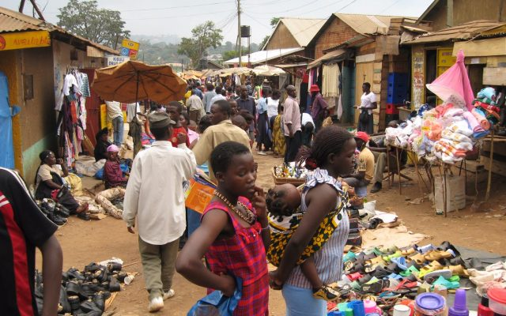
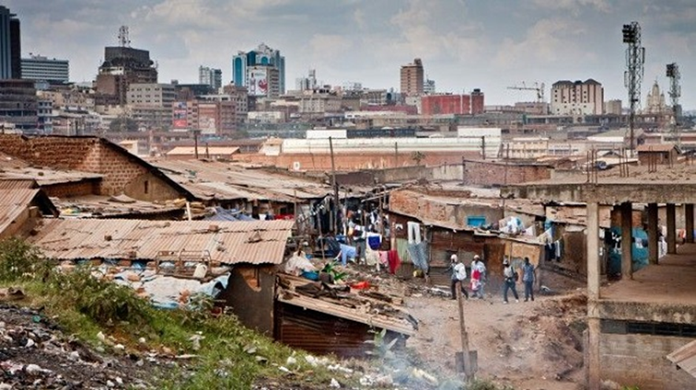
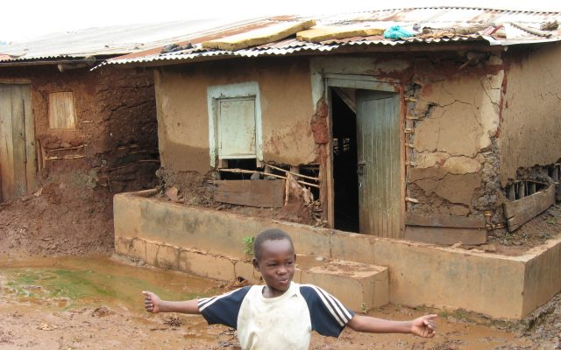
Housing and living conditions in slums in Kampala City

Slide 5

Contributory factors to continued development and expansion of slums
High urbanization rate
Urban poverty
Lack of urban planning and development control
Complex urban land tenure systems
The effect of decentralization and poor urban governance
Poor management of privatized urban services
Extension of boundaries of urban centres

Slide 6

National Slum Upgrading Strategy and Action Plan 2008
Goal: To improve the living conditions of slum residents living in the most depressed physical conditions in Uganda’s urban areas on a sustainable basis and to prevent future slum growth.
Objectives of Slum Upgrading
To develop affordable and participatory measures for upgrading housing conditions and related support infrastructure in slum areas.
To plan and implement in collaboration with stakeholders programmes and pilot projects to minimize, eliminate and curtail the growth of slums.
To harness central government’s and urban authority(ies)’s resources in enhancing the contribution of slums to the urban economy.
To ensure an appropriate institutional framework and mechanisms for effective implementation of slum upgrading programmes by different stakeholders.

Slide 7

Participatory Slum Upgrading Programme (PSUP)
Launched in 2008 as a tripartite initiative of the Secretariat of the Africa, Caribbean and Pacific Group of States (ACP), the European Commission (EU) and UN‑Habitat.
Mission: to improve the living conditions of the urban poor by encouraging and promoting a collaborative process which involves all stakeholders, thereby motivating countries to further dedicate efforts and resources to upgrade slums and prevent the formation of new ones.
Key aim: to promote the creation of an enabling environment for slum upgrading and to institutionalize a more positive outlook on slum dwellers.
Tailored to specifically deliver on SDG 11.1: “By 2030, ensure access for all to adequate, safe and affordable housing and basic services and upgrade slums”,
as well as SDG 1, SDG 5, SDG 6, SDG 7, SDG 10, SDG 16, and SDG 17.

Slide 8
  Rationale for the Revised Strategy and Action Plan
Changes in the national urban demographic, spatial and policy environment — in particular the National Housing Policy; National Urban Policy; Third National Development Plan (NDPIII)
Key new global development frameworks: Sustainable Development Goals (SDGs) — and SDG Target 11.1 on access to adequate, safe and affordable housing and basic services, and upgrading slums; adoption of the New Urban Agenda (NUA); introduction of smart city concepts.
The review of the current National Slum Upgrading Strategy and Action Plan identified policy, institutional, structural and financing gaps that need to be addressed in the formulation and implementation of a national slum upgrading programme.
The review identified opportunities that can facilitate the above, and policy and strategic entry points for such a programme. These include the National Housing Policy; National Urban Policy; NDPIII Sustainable Urbanization and Housing Programme Implementation Action Plan (PIAP) ; and lands, housing and urban development sector strategies and development plans.
The revised strategy and action plan will guide the formulation of a national slum upgrading programme with high human development impact in slums and informal settlements, and contribute to overall poverty reduction and elevation of the country’s development index.

Slide 9
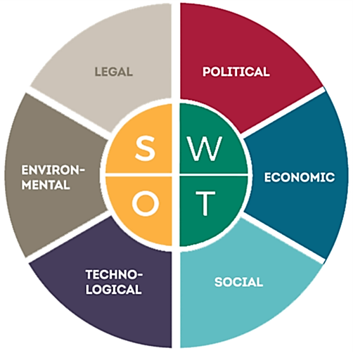
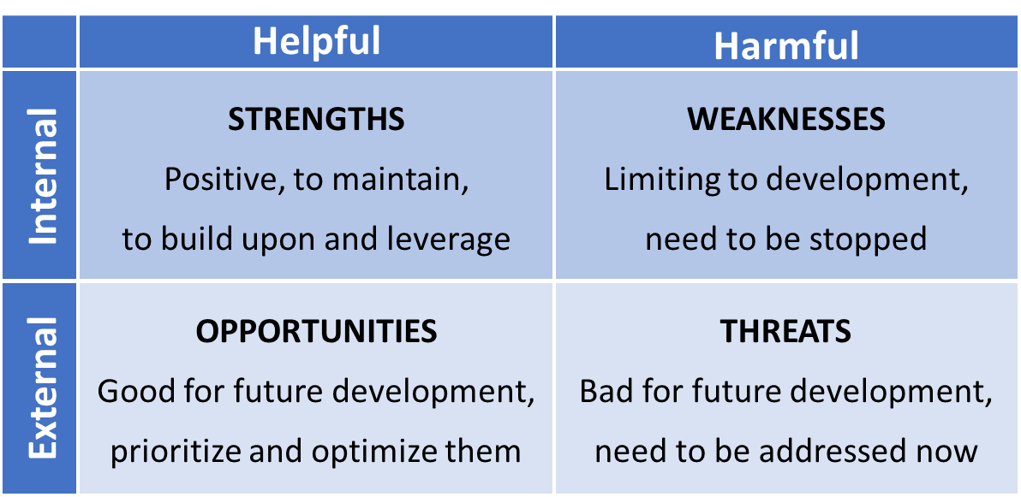
Integrated PESTLE framework and SWOT analysis

Slide 10
Factor | Strengths | Weaknesses | Opportunities | Threats
Political | Political stability Ruling party, NRM, supports slum upgrading as shown in 2021-2026 Manifesto Government has launched enabling policies, strategies and legislation City/Municipal Development Forums (CDFs/MDFs) provide multistakeholder participatory governance platform in which slum dwellers have a voice | Lack of awareness amongst politicians and government officials about the Strategy and Action Plan Lack of political support from higher level. Lack of capacity in municipalities Weak cooperation between local and national authorities and NGOs, CBOs Existing policy, strategy | Political stability enables development of short, medium and long term strategic planning scenarios Enabling policy, legal, and institutional framework Capacity development of local, central, and regional institutions and key stakeholders in slum upgrading by applying good governance and management approaches. | Myopic vision and lack of commitment of political class of urban authorities Negative perception of slums among some politicians, governmental officials and the media

Slide 11
Factor | Strengths | Weaknesses | Opportunities | Threats
Political | Existing local socio-political institutions exist in many slums Promotion of TSUPU amongst politicians and government officials about slum upgrading and affordable housing initiatives | Limited sensitization and awareness Lack of funding for implementation of the action plan | Momentum for change in status quo of slums. Municipalities that are supportive of slum upgrading and prevention Capacity building for municipalities More networking among key stakeholders — to achieve better coordination and more comprehensive improvements Development partners coordination platforms/forums

Slide 12
Factor | Strengths | Weaknesses | Opportunities | Threats
Economic | Initiative from Government to seek for donor support on slum upgrading and affordable housing development Donors willing to work with the Government and financially support slum upgrading interventions Programmes/projects implemented with financial support from development partners (e.g. PSUP, TSUPU, USMID) | Weak municipal revenue base Inadequate commitment of public funds to slum upgrading Poor coordination of donor funded slum upgrading-related interventions, e.g. TSUPU, PSUP. | Legal mandate to create funds for slum upgrading and prevention/ affordable housing development Potential expansion of municipalities’ revenue bases Private sector investment in slum upgrading Low income financial transformation: Leveraging of digital financial services Improved slum dweller connectivity to economic opportunities. | Inadequate budgetary allocations for slum upgrading and affordable housing development Donor volatility Inflation rate Exchange rate Lack of interest by private sector in getting involved in slum upgrading

Slide 13
Factor | Strengths | Weaknesses | Opportunities | Threats
Social | Parish Development Model (PDM). Slum communities willing and able to undertake slum profiling and enumeration. Domestically financed Youth Livelihood Programme (YLP) and Women-led enterprises (Uganda Women Enterprise Programme (UWEP). Community contracting model adopted for TSUPU. | Slum dwellers unaware of their rights and responsibilities Slum dwellers unwilling to participate in upgrading interventions (e.g. PSUP, TSUPU) | Slum dwellers desire for change which can be harnessed in participatory slum upgrading initiatives tremendous human and economic potential of slum dwellers YLP provides interest free revolving funds to unemployed and poor youth (aged 18-30 years) including youth living in slums, | Fast growing urban population Youth unemployment Weak CSOs/ CBOs High crime rates in some slums Weak disaster preparedness Difficulty of obtaining accurate data for planning purposes. Displacement as a result of slum upgrading interventions Slum dweller “fatigue”

Slide 14
Factor | Strengths | Weaknesses | Opportunities | Threats
Technological | Aerial mapping and satellite imagery NWSC pre-paid meter | Inadequate infrastructure and service delivery Poor quality of existing infrastructure in many slums | Drone technology Growing internet coverage Growing number of smart-phone users Digitization of the land registry Move towards digital certificates of customary ownership to secure land rights and improve land use | Urban sprawl Financial constraints to infrastructure development

Slide 15
Factor | Strengths | Weaknesses | Opportunities | Threats
Legal | Enabling legal and regulatory framework. Participatory land ownership and tenure analysis was conducted which allowed slum communities to be consulted to verify ‘official’ census data. | Lack of awareness and weak enforcement of legal and regulatory framework governing slum upgrading Slum dwellers unaware of rights and obligations Weak application and enforcement of legal and regulatory framework Incorrect categorization of land tenure systems in NSDFU and ACTogether slum profiles, and inconsistences in data. Inadequate land tenure security and insecure land-related investments | Women’s land rights have a strong legal basis, grounded in the Constitution, and are recognized in Land Act and Land acquisition Act. The Land Acquisition Act provides for acquisition of land for public purposes which includes for public housing and infrastructure.. | Residents of many slums on private and municipal land face the threat of eviction.

Slide 16
Factor | Strengths | Weaknesses | Opportunities | Threats
Environmental | Constitution of Uganda that guarantees a clean and healthy environment for all. Policies, legislation and regulations designed to protect the environment including The Water Policy, Wetlands Policy | Despite formal policy, acts and regulations, wetlands have continued to be drained and converted, including for development of slums. impacting adversely on the environment. | Draw on lessons learned from the Cities and Climate Change Initiative (CCCI) with respect to strengthening the climate change response of cities and local governments. | Environmental degradation owing to development of slums on environmentally sensitive sites Environmental pollution due to poor solid waste management Threat of disease due to inadequate access to safe water and improved sanitation facilities in slums

Slide 17
Combining the elements of a SWOT to create actionable strategies
S
(O-W) Strategies that make use of opportunities to overcome the
weakness points
W
(S-O) Strategies capitalizing on the strength points
through making use of opportunities
(W-T) Strategies that deal
with the weakness
points to control
the threats
(S-T) Strategies that make use of strength points
to avoid or mitigate
the threats
O
T

Slide 18
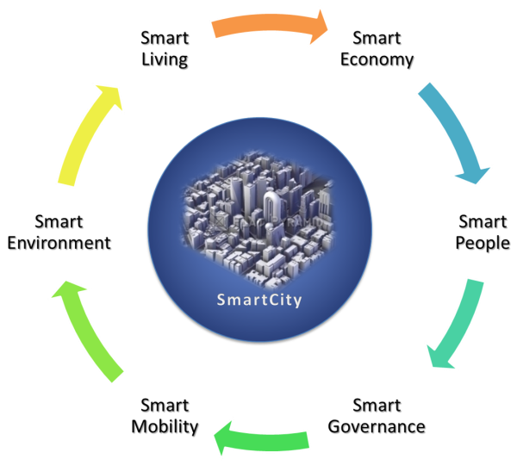
Smart City Concept
Definition:
“A smart city brings together technology, government and society to enable the following characteristics: a smart economy, smart mobility, a smart environment, smart people, smart living, smart governance.”
Institute of Electrical and Electronics Engineers (IEEE):

Slide 19
Characteristics and Factors of a Smart City
SMART GOVERNANCE (Participation) | SMART ECONOMY (Competitiveness) | SMART PEOPLE (Social and Human Capital)
Political perspectives and agendas Participation in decision-making Public and social services Transparent governance | Innovative spirit Entrepreneurship Economic image and trademarks Productivity Flexibility of labour market International embeddedness Ability to transform | Level of qualification Affinity to life-long learning Social and ethnic plurality Flexibility Creativity Cosmopolitanism Participation in public life
SMART MOBILITY (Transport and ICT) | SMART ENVIRONMENT (Natural resources) | SMART LIVING (Quality of life)
Local accessibility (Inter-)national accessibility Availability of ICT infrastructure Sustainable, innovative and safe transport systems | Attractivity of natural resources and conditions Pollution Environmental protection Sustainable resource management | Housing quality Access to infrastructure & services Health conditions Individual safety Education facilities Cultural facilities Social cohesion

Slide 20

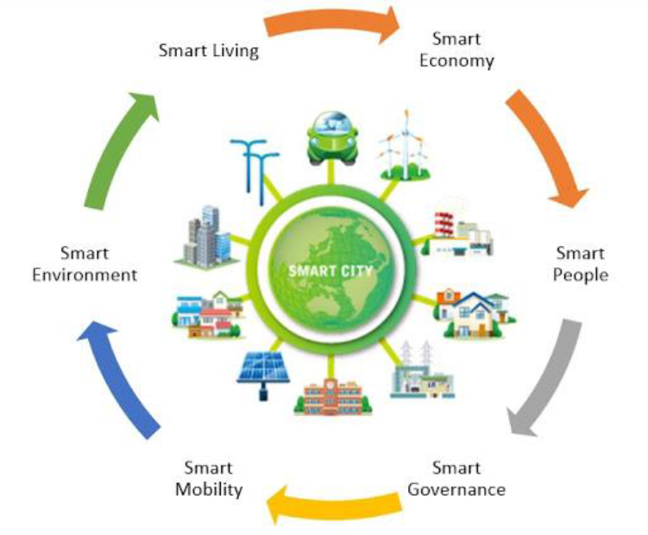
KCCA Smart City Strategic Plan 2020-2026
The Strategic Plan defines a Smart City as:
“A City area that solves its core issues through innovation and collaboration, and that applies new technologies and data for the benefit of all”.
KCCA’s Smart City interpretation is using technology to provide services to citizens.
Smart City Strategic Plan focus areas

Slide 21
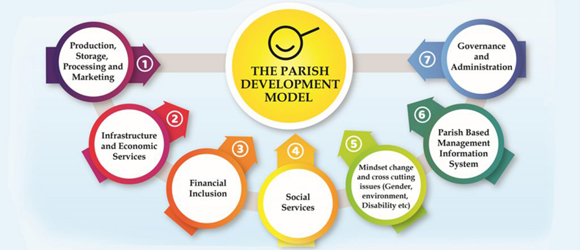
7 Pillars of the3 Parish Development Model (PDM)

Slide 22
Concept, Definition and Operationalization of Smart Slum Upgrading
‘Smart slum upgrading’, as articulated in the revised strategy, draws on the IEEE definition of a smart city, and is defined as :
“bringing together government, slum communities and technology to sustainably transform slums through smart governance, smart people, smart living, smart mobility, a smart economy and a smart environment”.
The smart slum upgrading concept puts people first and uses technology and smart approaches to transform the living conditions and lives of slum communities.

Slide 23
Smart Slum Upgrading
and Prevention
Strategy Framework

Slide 24
Vision: Adequate housing for all
Goal: Sustainable transformation of exiting slums and prevention of new slum formation
Strategy Objectives: Strengthen participatory, transparent and accountable governance of slums by improving implementation and enforcement of the policy, strategy, legal and institutional framework. Empower people and communities living in slums to effectively participate in decision making on and implementation of the Smart Slum Upgrading Strategy and ensure that interventions are inclusive and “leave no one behind (LNOB)”. Enhance local economic development (LED) and livelihoods in slums by harnessing public, private, non-governmental and community resources, and integrate slums into the wider economy. Improve the living conditions and quality of life of slum communities by increasing tenure security and implementing affordable and participatory incremental upgrading of infrastructure, services and housing. Improve mobility within and between slums and the wider city, and improve ICT connectivity and access to link slums communities with local, national and international resources and opportunities. Ensure sustainable environmental management and development of upgraded slums, and reduce vulnerability to climate change effects and natural disasters.

Slide 25
Strategy Principles Participation: All key stakeholders should be enabled to participate in decision making on, and implementation of the Smart Slum Upgrading Strategy and interventions. Equity: The implementation of the Smart Slum Upgrading Strategy and interventions should achieve equitable outcomes for all slum dwellers and communities. Affordability: Smart slum upgrading interventions and related elements of the housing supply chain (land, infrastructure, building materials, housing finance) should be affordable to slum communities. Localization: Smart slum upgrading initiatives should optimize local content and be locally appropriate, acceptable (socio-culturally sensitive) and adaptable, and promote local ownership. Cooperation: The Smart Slum Upgrading Strategy should facilitate the engagement of and coordinated, collaborative working between all key stakeholders at all levels and stages.
Strategy Principles Participation: All key stakeholders should be enabled to participate in decision making on, and implementation of the Smart Slum Upgrading Strategy and interventions. Equity: The implementation of the Smart Slum Upgrading Strategy and interventions should achieve equitable outcomes for all slum dwellers and communities. Affordability: Smart slum upgrading interventions and related elements of the housing supply chain (land, infrastructure, building materials, housing finance) should be affordable to slum communities. Localization: Smart slum upgrading initiatives should optimize local content and be locally appropriate, acceptable (socio-culturally sensitive) and adaptable, and promote local ownership. Cooperation: The Smart Slum Upgrading Strategy should facilitate the engagement of and coordinated, collaborative working between all key stakeholders at all levels and stages.

Slide 26
Strategy Enablers
Political will and support: The 2021-2025 Manifesto of the National Resistance Movement (NRM) elaborates measures to address the dual challenge of slums and affordable housing in line with the objectives of the Smart Slum Upgrading and Prevention Strategy .
Policy, strategy and legal framework: Uganda has an enabling policy, strategy and legal framework that can facilitate and support the implementation of the Strategy.
Institutional framework: The Local Government Act, Cap. 243 provides for the decentralisation and devolution of functions, powers and services at all levels of local governments to ensure good governance and democratic participation in decision making, thereby providing for a decentralized institutional framework conducive to implementing the Smart Slum Upgrading Strategy. There are also several ministries, departments and agencies (MDAs) with mandates related to slum upgrading.
Development Plans: The goal of the Third National Development Plan (NDP III) presents an overarching framework at the national level within which to implement the Smart Slum Upgrading Strategy.
The National Physical Development Plan (NPDP) and city and municipal physical development plans (PDPs) will also be critical enablers, as will be the Ministry of Lands, Housing and Urban Development (MLHUD) sector plans.

Slide 27
Strategy Enablers
Financing mechanisms: Uganda’s large infrastructure investment needs have led to a focus on non‐traditional financing mechanisms (e.g. a public‐private infrastructure fund), facilitated in large part by The Public Private Partnership Act, 2015. The Transforming the Settlements of the Urban Poor in Uganda (TSUPU) programme also established a number of innovative financing mechanisms.
Multistakeholder collaboration: The Uganda National Urban Forum (UNUF), the City Development Forums (CDFs) and Municipal Development Forums (MDFs) established under the TSUPU Programme will provide platforms for efficient, effective and sustainable stakeholder collaboration.
The Demographic Dividend will be harnessed by turning the young population living and working in slums into a healthy, competitive, innovative and productive human capital base

Slide 28

Smart Slum Upgrading and Prevention Strategy Actions
 | Pillar 1: Smart Governance (Participation)
Objective: | Strengthen participatory, transparent and accountable governance of slums by improving implementation and enforcement of the policy, strategy, legal and institutional framework.
Rationale: | Involving slum communities in decision making and implementation of upgrading interventions that affect them will enhance ownership and sustainability of smart upgrading interventions.
Actions: Leverage the political will to address the slum and affordable housing challenge expressed in the NRM Manifesto 2021-2025 through proactive targeted advocacy. Develop and implement, transparent and accountable urban governance by promoting e-Government and e-participation to reach a wider population. Optimize, strengthen and mainstream an enabling policy, strategy and legal framework for slum upgrading and new affordable housing development through multistakeholder engagement processes. Develop the capacity of, and enable the involvement of all key stakeholders in slum upgrading and affordable housing — including slum communities —in planning, decision making and budgeting through participatory approaches, using existing and new ICT systems where appropriate. Create a collaborative institutional ecosystem to synergize and leverage expertise, experience and resources of stakeholders, including slum communities.

Slide 29
 | Pillar 1: Smart Governance (Participation)
Actions: Facilitate communication and interaction among stakeholders in all sectors (public, private, NGO, academic and community) and strengthen critical coordination by strengthening the UNUF and CDFs, MDFs and settlement forums (SFs) established under TSUPU. Establish additional central and local government revenue sources for allocation to slum upgrading and affordable housing by developing non-conventional and innovative financing mechanisms. Actively seek and solicit, and provide a framework for domestic and foreign (donor funds) investment in slum upgrading and affordable housing. Engage CSOs to undertake continuous civic education on citizens’ constitutional rights and civic duties and responsibilities; and using multi-media channels and technologies. Raise awareness on key slum upgrading and affordable housing issues through appropriate media channels, including ICT and social media platforms for communication to stakeholders.

Slide 30

 | Pillar 1: Smart Governance (Participation)
Actors/Stakeholders |  | Key relevant policies, strategies, legislation, plans
OPM, Parliament MoLG, MGLSD, MoJCA, MoIA, MoICT&NG, MoFPED NPA, Other relevant MDAs Chairpersons of lower local governments ULRC, ULGA, UAAU, ULC, UCC, NITA-U UNUF, CDFs, MDFs, SFs NSDFU, SDI, NGOs, UHRC, ULA, SSA UN-Habitat, UNDP, Cities Alliance, World Bank, Sida |  | Constitution of Uganda NRM Manifesto 2021-2026 Uganda Vision 2040 The Decentralization Policy Local Government Act National e-Government Policy Framework The National NGO Policy The Human Rights (Enforcement) Act, 2019
NDP III SU&H Programme Objectives |  | SDGs
Objective 4: Enable balanced and productive national urban system Objective 5: Strengthen urban policies, governance, planning and finance |  | SDG 10: Reduced inequalities SDG 16: Peace, justice and strong institutions SDG 17: Partnerships for the Goals

Slide 31

 | Pillar 2: Smart People (Human/Social Capital)
Objective: | Empower people and communities living in slums to effectively participate in decision making on and implementation of smart slum upgrading and sustainable city initiatives that leave no one behind.
Rationale: | Enhancing human and social capital in slum communities to enable them to effectively participate in managing, envisioning and implementing smart slum upgrading initiatives will help ensure sustainable transformation of slums, while also strengthening social cohesion and resilience.
Actions: Empower people and communities living in slums to effectively participate in decision making on and implementation of smart slum upgrading initiatives through continuous civic education and awareness campaigns. Provide an accessible human capital improvement environment with physical and non-physical platforms with innovative technological features for advancement of knowledge, skills and sharing ideals.

Slide 32
 | Pillar 2: Smart People (Human/Social Capital)
Actions: Increase access to inclusive and quality Business, Technical and Vocational Education and Training (BTVET) and life-long learning opportunities through Open, Distance and eLearning (ODeL) Develop public-private partnership (PPP) in BTVET. Support and strengthen non-formal education (NFE) as a strategy for providing lifelong education, especially in order to ensure that special interest groups have easier access to education. Develop and implement smart forms of education, training and skills upgrading to facilitate career choices, labour market opportunities, vocational training as well as lifelong learning for all genders and age groups, and especially special interest groups; and issue certificates and licenses as appropriate. Build human capital to ensure that youth living in the slums have the skills to both access and create sustainable employment and income earning opportunities, through ICT skills, entrepreneurship skills and life skills. Expand slum dwellers access to medical and health services to enhance citizens health and wellbeing.

Slide 33
Actors/Stakeholders |  | Key relevant policies, strategies, legislation, plans
MGLSD, MOES National Population Council National Women’s Council (NWC), National Youth Council (NYC), Uganda Youth Network (UYONET) Uganda Civil Society Youth Coalition National Council for Older Persons Equal Opportunities Commission (EOC) UNICEF, UNIFEM, UNESCO Enabel, GIZ, Sida Private sector, PSFU CARE International, Plan International Makerere University – IODeL, CLL SSA MFIs, UMRA, Banks UGAPRIVI Village Health Teams (VHTs) CBOs, Women’s groups, Youth groups |  | National Population Policy for Social Transformation and Sustainable Development The Uganda Gender Policy 2007 National Policy for Older Persons National Child Policy 2020 The National Social Protection Policy Equity Promotion Strategy Paper UPE and USE Policies TVET Policy; BTVET Act 2008 The National Employment Policy for Uganda National ICT Policy for Uganda Persons with Disabilities Act, 2020 Equal Opportunities Commission Act 2007 Public-Private Partnership Framework Policy National Youth Action Plan Village Health Team Strategy and Operational Guidelines
NDP III SU&H Programme Objectives |  | SDGs
Objective 1: Enhance economic opportunities in cities and urban areas |  | Goal 1: No poverty Goal 3- Good health and well being Goal 4: Quality education. Goal 5: Gender equality Goal 11: Sustainable cities and communities Goal 12: Responsible consumption and production

Slide 34

 | Pillar 3: Smart Economy (Competitiveness)
Objective: | Enhance local economic development (LED) and livelihoods in slums by harnessing public, private, non-governmental and community resources, and integrating slums into the wider economy.
Rationale: | Strengthening LED will build the capacity of smart upgraded slums to improve their economic future and competitiveness; add to the stock of locally generated businesses and jobs; attract private sector investment; catalyze socioeconomic development; and reduce disparities between slums and other areas of the city.
Actions: Provide central and local government support to facilitate effective LED with a focus on poverty reduction and sustainable wealth; and operationalize the Parish Development Model (PDM) in all slums. Develop and roll out e-Government services to improve the ease of doing business; and ICT programmes that can improve extension services and delivery of government input support. Improve the business environment and ease of doing business in slums for start-ups, businesses, investors and new talent through an enabling legal and regulatory environment. Provide and support multi-purpose market or business premises with training facilities and free or subsidized internet access. Provide tailored support to increase entrepreneurship, innovation, productivity, quality and competitiveness of micro, small and medium-sized enterprises (MSMEs) and home-based enterprises (HBEs), including through USSD and digital platforms (e.g. mobile and smartphones, other ICT tools).

Slide 35
 | Pillar 3: Smart Economy (Competitiveness)
Actions: Provide tailored support to increase entrepreneurship, innovation, productivity, quality and competitiveness of MSMEs and HBEs, including through USSD and digital platforms (e.g. mobile and smartphones, other ICT tools). Support the establishment and operation of e-commerce (electronic commerce) and e business (electronic business), in particular by women and youth, through an enabling legal framework, providing ICT skills and e‑business training, and by facilitating internet access. Expand access to electricity and alternative green energy sources, and other infrastructure and services, for MSMEs, HBEs and other economic and productive activities Support expansion of trade and business opportunities for MSMEs and HBEs beyond local, city and national boundaries through competitive production techniques, innovation and value addition; and strengthening networking/market access. Develop PPPs and PPCPs to increase employment opportunities and introduce skills upgrading and workforce development programmes, in particular for special interest groups. Support and promote women, youth, and other vulnerable group led livelihood programmes, business initiatives and enterprises, and investment opportunities, including through use of technology and intelligent approaches. Improve financial inclusion through access to USSD and digital financial services (DFS); and affordable short-term financing on flexible terms for MSMEs and HBEs in smart upgraded slums

Slide 36

 | Pillar 3: Smart Economy (Competitiveness)
Actors/Stakeholders |  | Key relevant policies, strategies, legislation, plans
MLHUD, MOLG, MGLSD, MTIC, MoES, MoFPED, Local Councils UNBS, URSB UIRI, UNCST, UIA UMA, NITA MUBS-EC MFIs, UMRA, Banks ILO, UNCDF, UNIDO UNIFEM, MoICT&NG, NITA, internet service providers PSFU, FSD Uganda DFS providers |  | Local Economic Development Policy The National Employment Policy for Uganda Uganda MSME Policy National ICT Policy for Uganda Electricity Connections Policy Public-Private Partnership Framework Policy National Strategy for Local Economic Development The Public Private Partnership Act, 2015 The Tier 4 Microfinance Institutions and Money Lenders Act, 2016 UWEP, YLP, YLF UYCVF
NDP III SU&H Programme Objectives |  | SDGs
Objective 1: Enhance economic opportunities in cities and urban areas |  | SDG 1: No poverty SDG 8: Decent work and economic growth Goal 9: Industry, innovation and infrastructure

Slide 37

 | Pillar 4: Smart Living (Quality of Life)
Objective: | Improve the living conditions and quality of life of slum communities by increasing tenure security and implementing affordable and participatory incremental upgrading of basic infrastructure, services and housing.
Rationale: | Technologically appropriate and socially, economically, and environmentally sustainable interventions for urban living, and an innovative digital services ecosystem for education, health and social welfare will enhance the livability and quality of life of slum communities.
Actions: Improve living conditions in slums through multi-stakeholder implementation of the Smart Slum Upgrading Strategy and Action Plan Strengthen security of tenure and improve access to safe water, sanitation and other basic infrastructure through use of cost effective, incrementally upgradable and environmentally sound labour-intensive construction technologies; and promote community contracting to facilitate community participation in infrastructure development. Develop and strengthen capacity in green building design and construction, including of green homes., and raise awareness and promote change. Improve access to education, health and social welfare services and facilities, and other social services, facilities, and amenities, including through ICT and online service delivery options

Slide 38

 | Pillar 4: Smart Living (Quality of Life)
Actions: Mobilize, leverage and catalyze public, private and community resources to incrementally and sustainably transform slums — including through innovative PPP and PPCP projects Improve compliance to the rule of law and capacity to contain prevailing and emerging crime and security threats, including through civic educations, community-based policing, smart surveillance systems, smart security systems and installations (e.g. smart solar power street lighting, floodlights). Developing data capabilities within smart upgraded slums to advance evidence-driven strategies and interventions on safety for all, and in particular women, girls and other special interest group members. Improve digital inclusion by developing and executing an evidence-based, community driven comprehensive digital inclusion plan; and through PPP and PPCP initiatives (e.g. free/subsidized Wi-Fi hotspots in commercial and public places Improve financial inclusion through access to digital financial services (DFS), including digital savings and credit; and affordable short term financing on flexible terms for home improvements. Raise awareness of ICT and internet and their uses and benefits; and promote and support community-level initiatives for computer literacy.

Slide 39
 | Pillar 4: Smart Living (Quality of Life)
Actors/Stakeholders |  | Key relevant policies, strategies, legislation, plans
MLHUD, MGLSD, MOH, LGs, LCs, CDFs, MDFs, SFs Uganda Land Alliance, UCA, UHOCU, SSA NHCC, NWSC, ERA, UEDCL, Umeme, UECCC, UCC UN-Habitat, UNICEF, UNIFEM, GGGI GIZ, USAID, Sida, KfW Development Bank Habitat for Humanity, Plan International, Uganda Society of Architects, UIPP, UIE Private sector, PSFU MoICT&NG, NITA, Internet service providers MFIs, HFB, Banks, FSD Uganda, DFS providers |  | The Uganda National Land Policy The National Land Use Policy The Uganda National Urban Policy National Housing Policy National Environmental Health Policy Electricity Connections Policy The Physical Planning Act, 2010 The Water Act The Electricity Act The Public Health Act Physical Planning Standards and Guidelines.
NDP III SU&H Programme Objectives |  | SDGs
Objective 2: Promote urban housing market and provide decent housing for all Objective 3: Promote green and inclusive cities and urban areas |  | SDG 5: Gender equality SDG 6: Clean water and sanitation SDG 7: Affordable and clean energy

Slide 40

 | Pillar 5: Smart Mobility (Transport, Accessibility and ICT)
Objective: | Improve mobility within and between slums and the wider city, and improve ICT connectivity and access to link slums communities with local, national and international resources and opportunities
Rationale: | Well-planned and implemented transportation and mobility systems help support LED, connectivity, culture, creativity, and future developments; and also improve living conditions and the quality of the environment
Actions: Improve intra- and inter connectivity within and between slums and the wider city to facilitate mobility and movement of people, goods and services through ICT-supported approaches. Use data — including data collected through participatory methods using smart devices — to define mobility routes, including private and public vehicle routes, NMT routes, and safe and accessible walking routes. Promote public, private, and multi-lateral investments in mobility projects, including PPPs and PPCPs. Construct, upgrade and climate proof roads and transportation infrastructure with priority for public transport and service vehicles infrastructure, using labour intensive community based contracting.

Slide 41
 | Pillar 5: Smart Mobility (Transport, Accessibility and ICT)
Actions: Develop adequate, reliable and efficient multimodal transport network within slums that encourages walking, NMT, public transport and e-mobility solutions (e.g. electric motorcycles (e-boda bodas) and e-tricycles; electric-buses (e-buses). Prioritize and construct emergency vehicle accessible footpaths using innovative environmentally sound labour-intensive construction technologies and materials (e.g. recycled plastic paving stones). Enhance accessibility, connectivity and movement through an efficient and sustainable traffic management system with smart upgraded slums Develop and launch a multi-mode mobility app to coordinate: a) Pricing, availability and safety of transport; b) Feedback from clients regarding convenience of routes, route hazards and complaints regarding operators. Increase coverage and capacity of existing ICT and internet infrastructure and services.

Slide 42
 | Pillar 5: Smart Mobility (Transport, Accessibility and ICT)
Actors/Stakeholders |  | Key relevant policies, strategies, legislation, plans
MLHUD, MoWT URNA, URC, UTODA, SHODAU, SafeBoda, Boda associations Uganda Institute of Physical Planners (UIPP), UIE ILO, GIZ KMC, Zembo, Bodawerk |  | Non-Motorized Transport Policy, 2012 The Roads Act Uganda Road Fund Act The Traffic and Road Safety Act, 1998 (Amendment) Act, 2020.
NDP III SU&H Programme Objectives |  | SDGs
Objective 4: Enable balanced and productive national urban system |  | SDG 7: Affordable and clean energy SDG 11: Sustainable cities and communities SDG 13: Climate action

Slide 43

 | Pillar 6: Smart Environment (Resilience and sustainability)
Objective: | Ensure sustainable environmental management and improve environmental governance of smart upgraded slums, and reduce vulnerability to climate change effects.
Rationale: | By strengthening environmental management and governance, and hence environmental sustainability and resilience, assisted by smart technologies, smart slum upgrading can improve the living conditions and wellbeing of slum communities, with benefits for the wider city also.
Actions: Create an environment that is clean, healthy, comfortable and safe to live and work in at all times for communities in slums. Mainstream and strengthen implementation and enforcement of the existing enabling policy, strategy and legal framework to provide a safe and clean environment for slum communities. Raise awareness on citizens’ constitutional obligation to create and protect a clean and healthy environment (Article 17(j) of the Constitution of Uganda); and support Government efforts to promote sustainable development

Slide 44
 | Pillar 6: Smart Environment (Resilience and sustainability)
Actions: Promote and support community-led urban greening/urban green infrastructure initiatives, including urban agriculture, urban forestry and green storm management. Develop and strengthen community-led green management, including protection of gazetted environmentally sensitive areas and enforcement of legislation on occupation of the same. Use ICT in community-led sustainable environmental management, and environmental monitoring and early warning (e.g. early flood warning systems). Promote and encourage slum households to adopt the 5Rs of waste management — refuse, reduce, reuse, repurpose, and recycle. Develop and promote the use of smart waste technologies that use technology to make garbage collection more efficient, cost-effective and environmentally friendly. Promote and support the development of a sustainable and circular bioeconomy, based on urban agriculture and the philosophy of reuse, recycle and repurpose, while securing a healthy environment. Improve energy governance and administration; and reduce energy-related environmental impacts. Promote and implement affordable clean and smart energy technologies and services

Slide 45
 | Pillar 6: Smart Environment (Resilience and sustainability)
Actors/Stakeholders |  | Key relevant policies, strategies, legislation, plans
MoWE. MGLSD. MOWT, MEMD NEMA, NWSC CDFs, MDFs, SFs UN-Habitat, UNEP, UNFCCC, GGG! GIZ, USAID, Sida NSDFU Uganda Carbon Bureau, BEETA, SEforALL |  | The National Environment Management Policy National Policy for the Conservation and Management of Wetland Resources Uganda National Climate Change Policy A National Water Policy The Energy Policy for Uganda The Renewable Energy Policy for Uganda Uganda Green Growth Development Strategy The National Environment Act, 2019 The National Environment (Environmental and Social Assessment) Regulations, 2020 The Physical Planning Act, 2010
NDP III SU&H Programme Objectives |  | SDGs
Objective 3: Promote green and inclusive cities and urban areas |  | SDG 11: Sustainable cities and communities SDG 13: Climate action

Slide 46
Smart Slum Upgrading and Prevention Strategy
Implementation Arrangements
MLHUD ̶ overall oversight responsibility for
roll-out and implementation
National Slum Dwellers Federation of Uganda (NSDFU)
Slum communities
ACTogether
Office of the Prime Minister (OPM)
Ministries, Departments and Agencies (MDAs)
Inter-ministerial committees at cabinet level
National and local thematic and technical
multi-stakeholder structures and platforms
Development partners
Private sector; Professional sector
Academic institutions

Slide 47
Smart Slum Upgrading and Prevention Strategy
Results Framework
Level 1: Implementation of Smart Slum Upgrading Strategy actions under the six dimensions.
Level 2: Level of engagement of stakeholders in implementation of the Strategy actions.
Level 3: Overall outcomes shaped by Strategy actions and engagement of stakeholders

Slide 48
Smart Slum Upgrading Strategy Outcomes
Pillar 1: Smart Governance
Objective 1: Strengthen participatory, transparent and accountable governance of slums by improving implementation and enforcement of the policy, strategy, legal and institutional framework
1.1 Slums and affordable housing placed higher up on national development agenda.
1.2 Open, transparent and accountable rights responsive urban governance.
1.3 Efficient and effective implementation of the Smart Slum Upgrading Strategy and interventions.
1.4 Effective mobilization, leveraging and synergizing of stakeholder resources for implementation of smart slum upgrading initiatives.
1.5 Effective communication and interaction among stakeholders through Uganda National Urban Forum (UNUF), City Development Forums (CDFs), City Development Forums (MDFs) and Settlement Forums (SFs).
1.6 Effective participation of all stakeholders in implementation of smart slum upgrading initiatives.
1.7 More central and local funds available, approved and invested in smart slum upgrading initiatives.
1.8 Increased domestic and foreign investment in slum upgrading and affordable housing.
1.9 Informed and responsible slum communities.
1.10 Well informed stakeholders on key slum and slum upgrading, and affordable housing issues, and willing to participate in slum upgrading and prevention initiatives.

Slide 49
Pillar 2: Smart People
Objective 2: Empower people and communities living in slums to effectively participate in decision making on and implementation of smart slum upgrading and sustainable city initiatives that leave no one behind
2.1 Empowered slum dwellers and communities effectively participating in sustainable slum transformation
2.2 Educated and skilled slum communities effectively contributing to sustainable transformation of the slums.
2.3 High quality, affordable and accessible BTVET in smart upgraded slums
2.4 Accessible life-long learning opportunities for special interest groups
2.5 Multiple accessible smart education, training, skills upgrading and lifelong learning opportunities for all age groups in smart upgraded slums.
2.6 Enhanced youth employability and culture of youth entrepreneurship and job creation in smart upgraded slums.
2.7 Improved health equity and outcomes in slum communities; and reduced financial impoverishment from healthcare costs.

Slide 50
Pillar 3: Smart Economy
Objective 3: Enhance local economic development (LED) and livelihoods in slums by harnessing public, private, non-governmental and community resources, and integrating slums into the wider economy
3.1 Inclusive and sustainable LED transforming lives of people and communities living and working in slums.
3.2 Online accessibility of all government services and opportunities to support LED.
3.3 Robust business-friendly ecosystem that supports diverse enterprises to conduct business equitably.
3.4 Competitive micro, small and medium enterprises (MSMEs) and home-based enterprises (HBEs) producing quality goods and services for consumers within slums, as well as the wider city and beyond.
3.5 Robust, supportive and conducive e-commerce and e-business ecosystem that allows MSMEs to keep their businesses running, their employees connected and their customers engaged.
3.6 Widespread access to affordable electricity supply, alternative green energy sources, and other infrastructure and services for MSMEs, HBEs and other economic and productive activities.
3.7 Wider market access and increased profitability for MSMEs and HBEs in smart upgraded slums.
3.8 Members of special interest groups able to access employment opportunities.
3.9 Successful women, youth, and other vulnerable group led livelihood programmes, business initiatives and enterprises generating sustainable livelihoods,
3.10 Affordable, accessible credit to support MSMEs and HBES to expand for employment and wealth creation.

Slide 51
Pillar 4: Smart Living
Objective 4: Improve the living conditions and quality of life of slum communities by increasing tenure security and implementing affordable and participatory incremental upgrading of basic infrastructure, services and housing
4.1 Effective stakeholder engagement and collaboration in implementation of the Strategy and Action Plan, with consequent improved living conditions in smart upgraded slums.
4.2 Slum communities with secure tenure and sustainable access adequate to basic infrastructure, services and housing in smart upgraded slums.
4.3 Living conditions and quality of life of communities living in smart upgraded slums significantly improved.
4.4 Smart upgraded slums that continue to be transformed through innovative sustainable public-private partnership (PPP ) and public private community partnership (PPCP) projects.
4.5 A safer living environment for all smart upgraded slums, especially women and children and other special interest group members.
4.6 Widespread affordable access to ICTs and internet connections in smart upgraded slums, and reduction in the digital between slums and the wider city.
4.7 Affordable and accessible financial services readily available to previous underserved and excluded slum communities.

Slide 52
Pillar 5: Smart Mobility
Objective 5: Improve mobility within and between slums and the wider city, and improve ICT connectivity and access to link slums communities with local, national and international resources and opportunities
5.1 Efficient connectivity and mobility systems for the movement of people goods and services within and between smart upgraded slums and the wider city.
5.2 All weather accessibility, mobility and connectivity within smart upgraded slums.
5.3 Cleaner air environment in smart upgraded slums owing to reduced vehicular emissions and pollution.
5.4 More efficient and optimized movement of people and goods.
5.6 More affordable, efficient and convenient access to transportation options.
5.7 Accessible and affordable ICT and internet connectivity in smart upgraded slums.

Slide 53
Pillar 6: Smart Environment
Objective 6: Ensure sustainable environmental management and improve environmental governance of smart upgraded slums, and reduce vulnerability to climate change effects
6.1 Improved health and wellbeing of communities living and working in smart upgraded slums
6.2 Well-informed slum communities aware of their civic obligations and motivated to fulfil them.
6.3 Cleaner and aesthetically pleasing urban environment.
6.4 Well-managed, sustainable environment in smart upgraded slums with knock-on benefits for the wider urban environment.
6.5 Safe, climate resilient, and disaster-prepared communities
6.6 Aesthetically pleasing urban environment with reduced greenhouse gas emissions.
6.7 Healthy, garbage free environment for communities in smart upgraded slums with benefits for the wider urban environment
6.8 Increased energy security and Reduced energy poverty in smart upgraded slums.

Slide 54

Figure 9: Smart Upgraded Slum Dimensions, Factors and Characteristics
SMART GOVERNANCE
(Participation)
SMART ENVIRONMENT
(Resilience and Sustainability)
SMART PEOPLE
(Human/Social Capital)
SMART
UPGRADED
SLUMS
Smart Upgraded Slums
SMART MOBILITY
(Transport Accessibility and ICT)
SMART ECONOMY (Competitiveness)
SMART LIVING
(Quality of life)

Slide 55
Sustainable transformation of exiting slums and prevention of new slum formation

