Slide 1
Ministry of Lands, Housing and Urban Development, Uganda
The Land Conference
2023
Mobilizing Stakeholders to Modernise Land Management

Slide 2
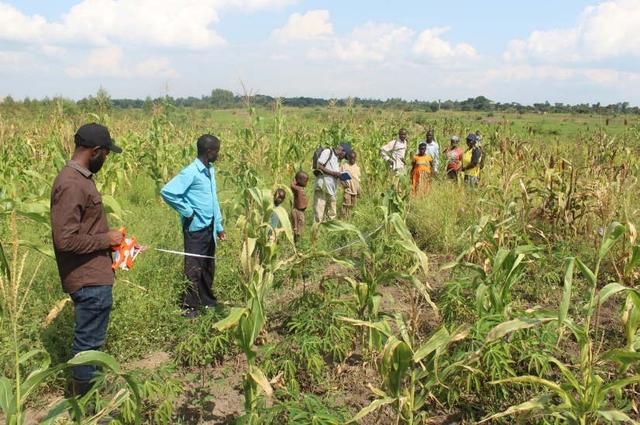
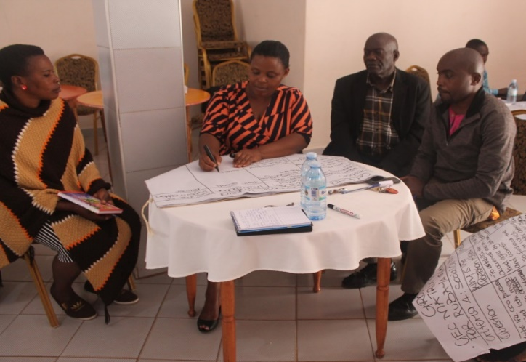
Systematic Land Adjudication and Certification (SLAAC) Project
Stakeholder Analysis
Toko Godfrey
CARTOGRAPHER
Mbr, ISU

Slide 3
Presentation Outline
01
02
04
05
06
07
03
Project Background
Project Breakdown
Project Timeline
Project Stakeholders
Role of the Stakeholders
Engagement Routes
Benefits of Stakeholder Involvement

Slide 4
01
Project Background

Slide 5
Brief on the Project
LSSP I piloted Systematic Demarcation (SD) of land. The overall aim was to enhance security of tenure, ownership and management of land with the ultimate goal of uplifting the livelihoods of the poor and vulnerable groups in Uganda.
The pilot was carried out in phases in Rukarango in Ntungamo District, Aminit in Soroti District, Bulowooza in Iganga District, Bumbobi and Bumasikye in Mbale District and Bwanswa in Kibaale District.
The Systematic Land Adjudication and Certification (SLAAC) Project Phase 1 from 2017-2020 took place in Oyam, Mbarara, Kiruhura and Ibanda districts with 32 parishes – 66,148 Parcels.

Slide 6
Brief on the Project – cont’d…
The Systematic Land Adjudication and Certification (SLAAC) Project Phase 2 from 2023-2024 in 16 districts of Oyam, Apac, Maracha, Soroti, Serere, Bukedea, Namutumba, Kamuli, Luuka, Mayuge, Jinja, Isingiro, Ntungamo, Kikuube, Sheema and Ibanda with 472 parishes – 930,000 Parcels.
The Systematic Land Adjudication and Certification (SLAAC) Project Phase 2 from 2023-2024 in Oyam and Apac is named SOYAp – 74,000 Parcels.

Slide 7
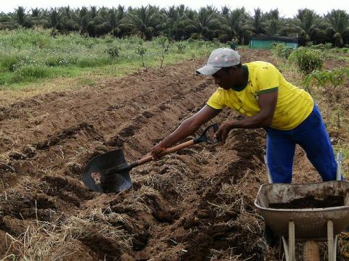
02
Project Breakdown

Slide 8
SLAAC Project Components
Component 1
Component 2
Component 3
Mobilisation, Preparation and Sensitization.
Preparatory activities (mobilization, survey of parish boundaries, extension of survey controls, reviewing the physical development plans, training of adjudication teams and preparation of tablets or survey equipment.
Systematic Adjudication, Demarcation and Recordation – PERI URBAN
All activities necessary for the adjudication, survey, demarcation and recordation of land rights for Peri-Urban Areas or High Value Rural Areas.
Systematic Adjudication, Demarcation and Recordation – RURAL
All activities necessary for the adjudication, survey, demarcation and recordation of land rights for Rural Areas.

Slide 9
03
Project Timeline

Slide 10
Project Implementation Schedule
Procurement
Inception
6 months
1 month
Implementation
Wrap Up
8 months
1 month

Slide 11
04
Project Stakeholders

Slide 12
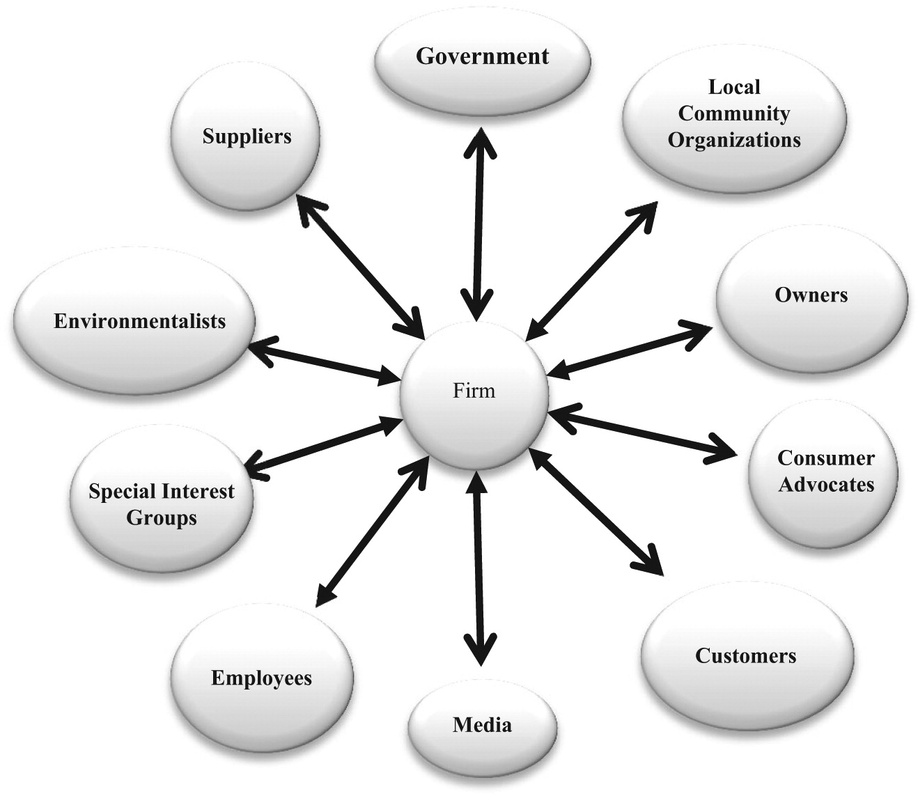
SLAAC
Project

Slide 13
Who are the Stakeholders?
Institutions
Administrators
Managers
Universities
Other Tertiary Institutions (ISLM)
Professional Bodies (ISU)
Central Gov’t Level
Local Gov’t Level
NGO Partners
CDOs
Dev’t Partners
Politicians
Beneficiaries
World Bank
Cooperations
Parliamentarians
Councilors
Land Owners
SACCOs
Banks

Slide 14
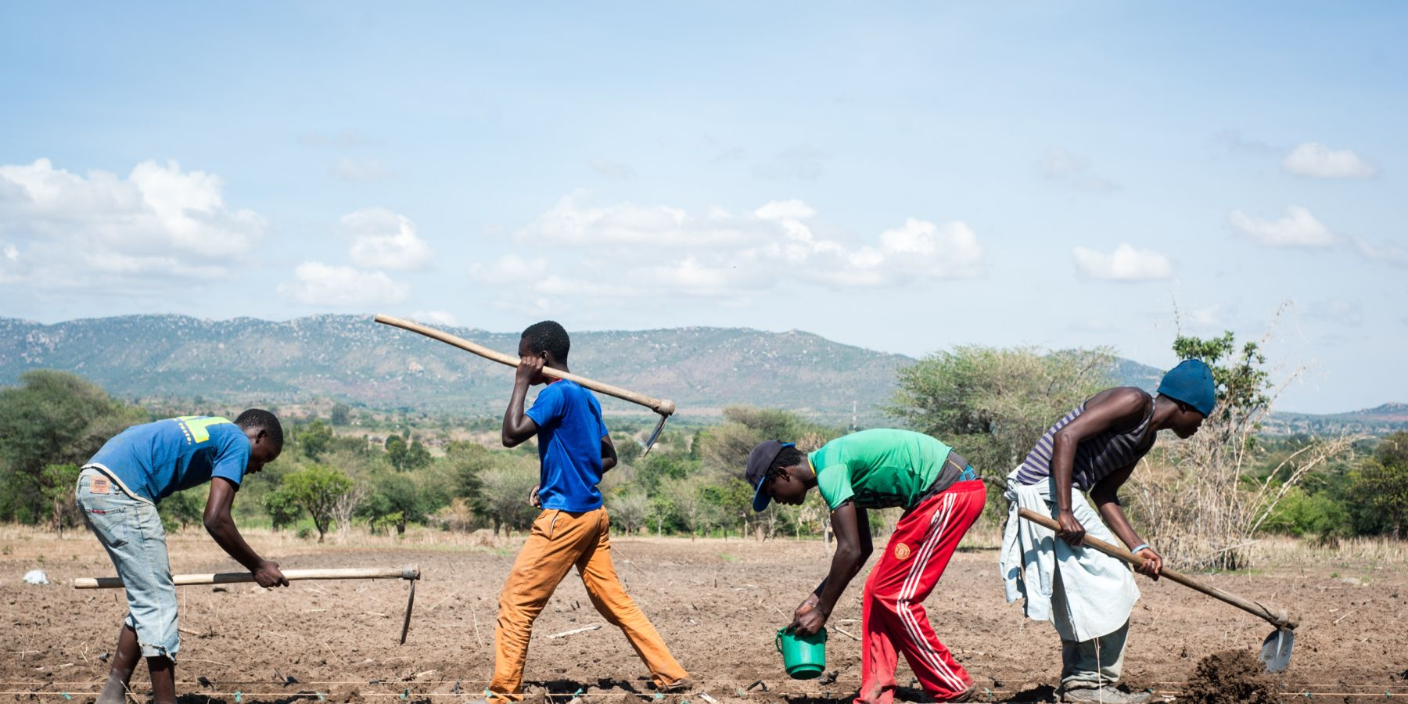
05
Role of the Stakeholders

Slide 15
Key to Note
360 – Degree Mgt
Perspectives
Participation of all stakeholders for situation view of the Project
Different Stakeholder have different Perspective
Expectations
Evaluation
Different Stakeholders have different Expectations
The Final Project Approval (FPA) depends on all stakeholders statistical Weight

Slide 16
What is your Role?
Exchange Ideas – insights
Participation – support
Stakeholders Input – guidance
Scope Mgt – oversee
Monitoring - suggestions
Time Mgt – remind
Provide – in kind
Supervision – presence
Evaluate – discussions

Slide 17
06
Stakeholder Engagement Routes

Slide 18
Stakeholder Communication Routes in SLAAC
Trainings
Working
Others
Meetings
Management Decisions
Gain/Transfer Knowledge
Workshops
Exhange Lessons Learnt
Participate and Progress
Conferences
Share resources and ideas
Media, Phone Calls, Emails, etc

Slide 19
07
Benefits of Stakeholder Involvement

Slide 20
Stakeholder Benefits
Accountable Stakeholders
STAGE 4
STAGE 1
STAGE 2
STAGE 3
Commitment
Effective Communication
Trust among Stakeholders
STAGE 5
STEP 8
STAGE 6
Project Priority
STAGE 7
Transparent Activities
Motivated Sponsor and Stakeholders
Project Sustainability

Slide 21
GEOSPATIAL ROADMAP TO SDGs, NDP IV, VISION 2040, etc
Spatial Planning
National Physical Development Plans
National Geospatial Portal
Revise all the 320 National Topographic Maps
National Tourist Maps
National Geodetic Framework

Slide 22
THANKS!
DO YOU HAVE ANY QUESTIONS?
tokoetole@gmail.com
+256-783-632-181
mlhud.go.ug

