Slide 1
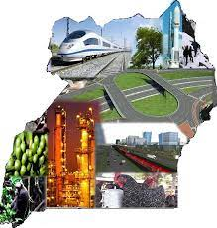
MINISTRY OF LANDS, HOUSING AND URBAN DEVELOPMENT
ROLE OF LAND MANAGEMENT TO NATIONAL DEVELOPMENT
Smith .T Matsiko
ASSISTANT COMMISSIONER M&E
LAND COFERENCE 2023
22nd – 23rd 2023

Slide 2
Presentation outline
Key achievements in the land sub programme
Revenue Generation
NDP III
Land management – Budget Outlook
Impacts of land reforms
Land reforms
Land as a Resource

Slide 3
NATIONAL DEVELOPMENT PLANNING FRAMEWORKS
National Development Plan
NRM Manifesto
Sustainable Development Goals(SDGs)
National Physical development Plan(integrated Planning)
Legal and Policy Framework

Slide 4
LAND MANAGEMENT ALIGNMENT TO THE NDP III
NDPIII VISION
“A Transformed Ugandan Society from a Peasant to a Modern and Prosperous Country within 30 years”
NDPIII GOAL
“To Increase Average Household Incomes and Improve the Quality of Life of Ugandans”
THEME
“Sustainable Industrialization for inclusive growth, employment and sustainable wealth creation”

Slide 5
LAND MANAGEMENT ALIGNMENT TO THE NDP III (2020/21 – 2024/25)- Programmatic approach
Natural Resources, Environment, Climate Change, Land and Water Management
Objective:
“Strengthen land use and management”
Result Areas
Increase the percentage of titled land from 21 percent to 40 percent;
Reduce land related conflicts by 30 percent

Slide 6
Sub program Interventions:
Complete the rollout and integration of the Land Management Information System with other systems.
Fast-track the formulation, review, harmonization, and implementation of land laws, policies regulations, standards and guidelines.
Undertake a comprehensive inventory of Government land.
Capitalize the Land Fund to ensure access to land by lawful and bona fide occupants.
Strengthen the capacity of land management institutions in executing their mandate geared towards securing land rights.
Promote land consolidation, titling and banking.
Acquire land for infrastructure/utility corridors
Promote tenure security including women’s access to land.
stablish the National Spatial Data Infrastructure (NSDI) to enhance data integration for planning and development;
Develop and implement a Land Valuation Management Information System (LAVMIS);
Promote integrated land use planning

Slide 7
QUICK FACTS
Land area (sq. km)
241,551 km²
Average Days for land Transaction
15 days
Land disputes mediated
54.16%
Property Valuations
187,615
Active District Land Boards
135
LEVEL OF PHYSCAL PLANNING
32.9%
Proportion of land cases to court cases
68%
Percentage of land registered(Security of tenure)
30%
Revenue Generated (LIS)
~ UGX 950bn- 2013-2023
% of The International Border Surveyed
20%
Ministry Zonal Offices
22
Proportion of Districts with Land Officers
83.7%

Slide 8
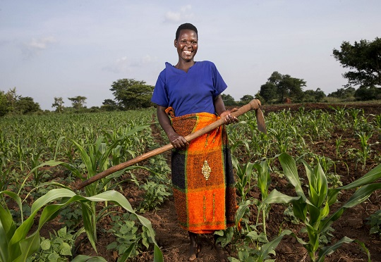
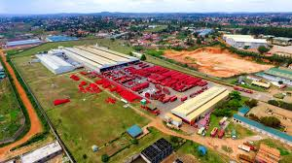
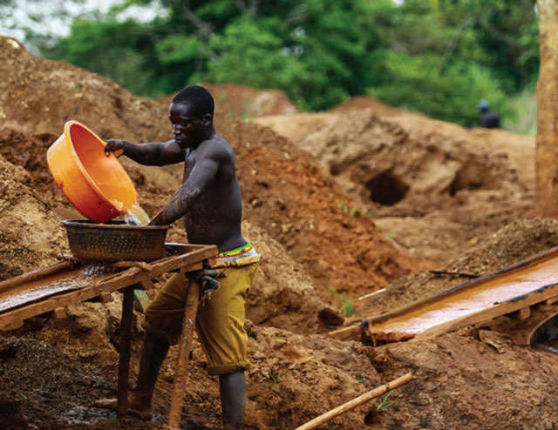

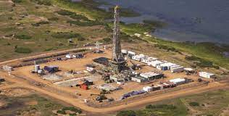
LAND AS A RESOURCE
Land is a valuable resource in Uganda, not only for its agricultural potential but also as a means of livelihood for many people.

Slide 9
LAND REFORMS
Land reforms are a key strategies that have been pursued by the government of Uganda to promote socio-economic transformation in the country. The following are some of the major reforms undertaken by the government in regards to land management:
Land Information System
Legal and Policy frameworks(NLP, Land Act etc)
Systematic Land Adjudication And Certification
Issuance of CCOs
CLAs, etc

Slide 10
IMPACTS OF LAND REFORMS
A) Improved Land Tenure Security(30%)
Land reforms improved the security of land tenure for small landholders, especially in rural areas. Prior to the reforms, land usage was regulated under the customary land tenure system, which often resulted in disputes over land ownership. The reforms have helped in instituting the formal registration of land ownership, which has reduced conflicts over land ownership and in turn improved land use.

Slide 11
IMPACTS OF LAND REFORMS
B) Promoting Agricultural Development(70%- WB,2018)
The land reforms have facilitated the growth and development of the agricultural sector, which is a major source of employment and income in Uganda, with agriculture being the backbone of the country's economy. The reforms have promoted commercialization of agriculture among smallholder farmers, which has led to increased productivity and income, particularly in cash crop production areas.

Slide 12
IMPACTS OF LAND REFORMS
C) Enhanced Access to Credit(1.65 trillion or USD 660 million (4.8 percent of GDP)
The registration of land ownership through the reforms have provided security to lenders, allowing farmers and other landowners to access credit and bank loans using land as collateral. The availability of credit has driven investments in agriculture, social services resulting in increased production and higher incomes.

Slide 13
IMPACTS OF LAND REFORMS
D) Increased Foreign Investment(1.1bn-UNCTAD 2022)United Nations Conference on Trade & Development
The reforms have facilitated foreign investment by making it easier for investors to acquire land in Uganda. This has resulted in increased foreign investment in Uganda, as investors are attracted to the country’s large agro-industrial potential.

Slide 14
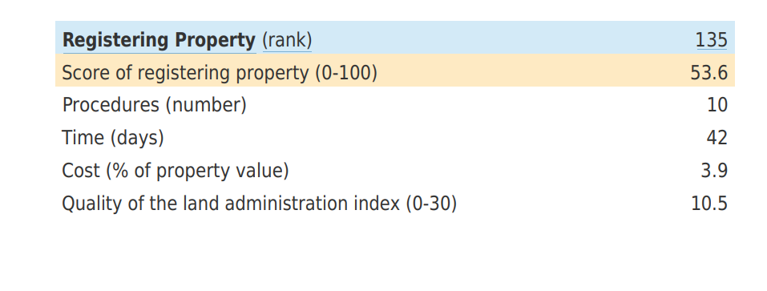
IMPACTS OF LAND REFORMS
E) Reduced Cost of Doing Business(12th in Africa-WB)
The reforms have reduced the cost of doing business through reduced turn around time for land registration/transaction and extending land registration and other services closer to communities.
Source: Doing Business , 2020

Slide 15
IMPACTS OF LAND REFORMS
F) Improved Women’s Access to Land(26%- Kevin Eze, ILC Africa, Landesa 2023)
The land reforms such as CCOs and COs have also facilitated women's access to land ownership. Uganda has a patriarchal society that occasion marginalization of women. Reforms have lessened this stereotype thus providing women with more equal opportunities to access and own land thus improving their economic status.

Slide 16
IMPACTS OF LAND REFORMS
G) Environmental Conservation(494 titles cancelled in WL)
The Land information System has aided conservation of titles by thwarting issuing of land titles in environmentally sensitive areas and also support cancellation of titles that had been issued in protected areas.

Slide 17
IMPACTS OF LAND REFORMS
H) Projects Performance
Improved project performance is attributed to reforms under land acquisition that have reduced turnaround time of land acquisitions for infrastructure performance which in turn have improved perfromance by time, scope, and on Budget/cost. The estimated savings reported by UNRA is UGX 32bn annually.

Slide 18
IMPACTS OF LAND REFORMS
H) Fiscal contribution( revenue 659.48 FY 2021/22-MLHUD; Expenditure efficiency -32bn Annually- UNRA)
Land reforms have also contributed to increased revenue performance through improving efficiencies in generating Taxable and Non taxable revenues.
On the Government expenditure front, the reforms have improved the quality of valuations for land acquisition which have lessened Government expenditure burdens on compensations.

Slide 19
IMPACTS OF LAND REFORMS
H) Improved Social security(30%)
Land is a major social safety net in terms of -unemployment security, minimum living security value, old-age security value and medical security

Slide 20
KEY ACHIEVEMENTS IN THE LAND SUB PROGRAMME
S/N | Key Performance Indicator | Baseline | Progress to date | Remarks
1 | Average Time to process a transaction(Transfers and Mortgages) | 180 days (2013) | 15 days | The introduction of the LIS improved the efficiencies in land registration
2 | Levels of compliance to Physical planning. (Where physical plans exist) | 20% (2015) | 52% | This accounts for only 15% of physical planning in Uganda, leaving a gap of 85% that need to be achieved at all planning levels.
3 | New Titles produced | 450,000 (2013) | 2.42M | Adaptation of supply driven approach through SLAAC and also intensified sensitization
4 | Land Acquisition (Projects) | 123 (2015) | 1,217 | Good performance, however still far from additional 200 projects with a portfolio of UGX 8Trn required under the NDPIII

Slide 21
PERFORMANCE HIGHLIGHTS
S/N | Key Performance Indicator | Baseline | Progress to date | Remarks
5 | Level of Physical planning | 3% (2015) | 15% | This explains the proliferation of slums and complexity in infrastructural services e.g. water, high cost of land acquisition for infrastructure projects etc.
6 | International boarder surveyed | 112 (2015) | 545 Kms | This is 20% of the total 2,729kms of the border line
7 | Percentage of land disputes mediated | 20% (2015) | 54.16% | This had reduced land conflicts and evictions . However there is need to intensify land registration
8 | Certificate of Customary Ownership titles (80% of land is held is under customary tenure) | 0 (2013) | 9,325 | The CCO module for CCO register is being developed under the LIS to improve registration

Slide 22
PERFORMANCE HIGHLIGHTS
S/N | Key Performance Indicator | Baseline | Progress to date | Remarks
9 | Level of Digitization of Land records | 0% (2009) | 45% | The gap is as a result of incomplete documentations, which the Ministry is embarking on through file commitments(Matching manual to digital file on the system)
10 | Average annual Land searches | 300 (2013) | 2M | Increase in access and availability of information to the public
11 | Titles in Wetlands cancelled | 0 (2015) | 494 | Implementing President’s efforts towards restoration of fragile ecosystems and protected areas. Introduction of LIS, registration of titles in the wetland are no longer possible. The delays are occasioned by litigations by the owners

Slide 23
PERFORMANCE HIGHLIGHTS
S/N | Key Performance Indicator | Baseline | Progress to date | Remarks
12 | Ministry Zonal offices operationalized | 6 (2013) | 22 | This justifies the increased volumes of land transactions.
13 | Percentage of registered land (Tenure security) | 12% (2013) | 30% | The gap of 70% explains the increased land conflicts and rampant land grabbing affecting the productivity of land and land related investments.
14 | Public and Corporate portals | 0 (2015) | 5 | URA, NITA-U, NIRA, URSB and online public portal. These increase access and availability of information which mitigate middle men, corruption tendencies among others
15 | Property Valuations | 25,000 (2015) | 187,615 | This improvement in performance has been as result of asserted efforts to strengthen the valuation office through retooling and capacity building

Slide 24
PERFORMANCE HIGHLIGHTS
S/N | Key Performance Indicator | Baseline | Progress to date | Remarks
16 | Resolve the issue of Bibanja land ownership (Presidential Directive) | - | Amendments to the legal framework | Undertaking Amendment to the entire legal and policy frameworks and compensations
17 | Development and Review of Legal Frameworks | 1 (2015) | 10 laws, policies and regulations under review | RTA, Land Act, Land regulations, Real Estate, Physical planning Act, Land Acquisitions, Mortgage regulations, land Valuation bill
18 | Systematic Land Adjunction And Certification Roll out | 0 (2013) | 66,148 parcel s demarcated and surveyed | Scale up the whole country, resources permitting

Slide 25
REVENUE GENERATION
ANALYSIS OF MoLHUD REVENUE GENERATION FY 2020/21 – FY 2021/22
S/N | SOURCE | FY 2020/21 Bns | FY 2021/22 Bns
1 | Property Tax Valuation | 245.50 | 253.44
2 | Capital Gains Valuation | 175.15 | 183.82
3 | Probate Valuation | 92.00 | 96.55
4 | Rental Valuation Assessments | 63.25 | 66.38
5 | Stamp duty Assessments | 24.36 | 39.37
6 | Other Valuations (Asset disposal, custodian board, boarding off) | 10.04 | 14.73
7 | NTR (Land fees) | 3.78 | 5.20
 | TOTAL | 614.07 | 659.48
Source: NLIS and MLHUD, 2023
Since the operationalization of the 22MZOs and rollout of the LIS in FY 2017/18, the Ministry’s revenue generation tremendously increased to an average of UGX 650bn on annual basis. This is as a result of automation of the land services.
The implementation of the Land Valuation Management Information System (LAVMIS) and integration with LIS shall streamline valuation and the revenue is expected to more than double in the medium term.

Slide 26
PERFORMANCE OF LIS REVENUE GENERATION
Financial Year | Revenue Generated
2013/2014 | 102,904,043,887
2014/2015 | 85,596,322,116
2015/2016 | 242,423,305,272
2016/2017 | 128,361,534,050
2017/2018 | 45,458,474,744
2018/2019 | 147,996,307,173
2019/2020 | 27,602,182,186
2020/2021 | 28,140,094,107
2021/2022 | 64,710,000,000
2022/2023 | 77,258,000,578
TOTAL | 950,450,264,113
Projections
2023/2024 | 105,821,372,700
2024/2025 | 123,708,022,459
The Ministry through the LIS has generated cumulatively over Ugx 950bn and If the operational and maintenance costs of the system & land offices are adequately funded, the system is projected to generate over
Ugx 228bn p.a over the medium term as the economy is full recovers from COVID19 pandemic

Slide 27
Other Sources of Revenue Generation
Probate
Ground Rent
Conversion
Property Tax
Assets Disposal
Rental for Government property
Capital gains
Premium

Slide 28
Land Management - Budget Outlook
Year | Land Management Budget (Bns) | National budget (Bns) | Percentage
FY 2017/18 | 58.87 | 29,000 | 0.20%
FY 2018/19 | 98.35 | 32,702 | 0.30%
FY 2019/20 | 36.34 | 40,487 | 0.09%
FY 2020/21 | 36.34 | 45,493 | 0.08%
FY 2021/22 | 42.313 | 44,778 | 0.09%
FY 2022/23 | 123.659 | 48,130 | 0.26%
FY 2023/24 | 70.195 | 52,790 | 0.13%
Despite the revenue contribution and key role of land management in the socio-economic transformation of the country, its budget allocation remains one of the least with average budget share of 0.16% of the total national budget.

Slide 29
Challenges
CHALLENGE/ SHORTFALL | PROPOSED SOLUTION
Wage Shortfall | Provide UGX 3.5BN to meet the staffing shortfalls in the MZOS. The current staffing in the MZO is at 45%
LIS maintenance | Provide for UGX 6.7BN to Replenish the LIS infrastructure and establish portals and integration with other Government systems.
Inadequate funding Ministry Zonal Offices | Provide for UGX 10.5bn for operations and maintenance to bring land services closer to the community and improve land tenure security
International Boarder reaffirmation and demarcation | Provide for UGX 4.8Bn for boarder demarcation to improve security amongst boarder communities along the Uganda – South Sudan border, Uganda -DRC and Uganda - Kenya
Low levels of Land registration/ land tenure security (30%) | Implementation of SLAAC Supply and demand driven approach to land registration. Government needs to subsidize the cost of titling by providing funds for surveying and other fit for purpose approaches . Land is a major factor of production/ ‘wealth’ of a Nation and should be secured

Slide 30
SECTORS LARGELY DEPENDABLE ON LAND
The table below shows key sectors identified to drive Uganda’s Vision 2040 agenda and their dependance on land. This implies that the safety of investment in these areas largely depends on tenure security.
Sector | Level of Dependency
Agriculture | High
Infrastructure | High
Energy | High
Tourism | High
Oil and gas | High

Slide 31
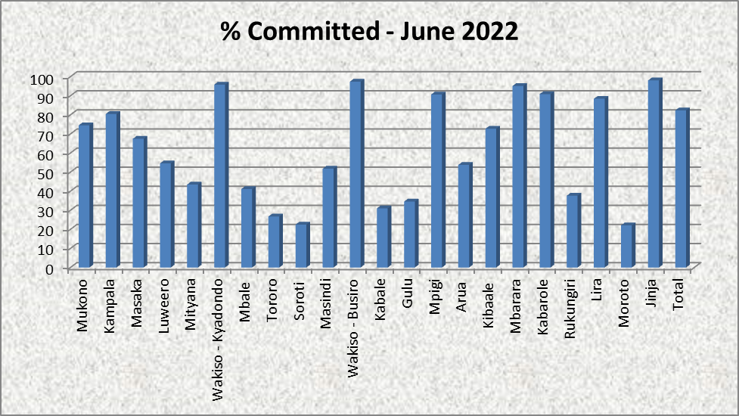
LIS Efficiency stats

Slide 32
LIS efficiency Stats

Slide 33
DETAILED PEFORMANCE ANALYSIS

Slide 34
Performance Analysis
Strengthening Land use and management
Rolled out Systematic Land Adjudication and Certification (SLAAC) in 5 districts of Mbarara, Kiruhura, Rwampara, Ibanda and Oyam under CEDP; and for refugee host communities under USMID-AF in 8 districts. Rolled out the Certificate of Customary Ownership (CCO) and Certificate of Occupancy (CO) programmes in the country. In case of CCOs, this has been implemented in the districts of Namutumba, Terego, Dokolo, Amolatar, Soroti, Katakwi, Apac, Maracha, Agago, Mbale, Butaleja and Karamoja sub-region. For COs, they have been undertaken in the districts of Mityana, Mubende, Kasanda and Gomba. To date, the programme has mapped 87,065 parcels under Mailo land in the stated 4 districts with support from GIZ In regards to CCOs, nine thousand three hundred twenty five (9,325) certificates have been issued out of the total 23,586 parcels demarcated and mapped.

Slide 35
Detailed Performance/ Achievements
Strengthening Land use and management
Rolled out Systematic Land Adjudication and Certification (SLAAC) in 5 districts of Mbarara, Kiruhura, Rwampara, Ibanda and Oyam under CEDP; and for refugee host communities under USMID-AF in 8 districts. Rolled out the Certificate of Customary Ownership (CCO) and Certificate of Occupancy (CO) programmes in the country. In case of CCOs, this has been implemented in the districts of Namutumba, Terego, Dokolo, Amolatar, Soroti, Katakwi, Apac, Maracha, Agago, Mbale, Butaleja and Karamoja sub-region. For COs, they have been undertaken in the districts of Mityana, Mubende, Kasanda and Gomba. To date, the programme has mapped 87,065 parcels under Mailo land in the stated 4 districts with support from GIZ In regards to CCOs, nine thousand three hundred twenty five (9,325) certificates have been issued out of the total 23,586 parcels demarcated and mapped.

Slide 36
Performance Analysis
Strengthening Land use and management
673 Communal Land Associations (CLAs) have been formed and registered. Acquired land for development purposes e.g Amuru land for sugar works. Between 2015 and 2020, the National Land Information System (NLIS) was developed and rolled out to all the 22 Ministry Zonal Offices constructed by Government across the country. The System currently prohibits titling over wetlands, natural resources, and other fragile ecosystems due to the checks and quality control process involved. This has necessitated cancellation of all those titles erroneously issued during the manual system. The total titles under the NLIS increased from 450,000 in 2013 to approximately 2.42M in 2023 Reduced the average time taken to register land from 52 days in 2013 to 15 days.

Slide 37
Performance Analysis
Strengthening Land use and management
A total of 54.16% land disputes have been mediated i.e. 3,146 out of 5,808 land conflicts. Between FY 2013/14 – FY 2022/23, the Ministry has been able to generate UGX 873bn. The System was integrated with other systems such as URA, NIRA, URSB etc The Ministry launched the Public and Corporate Portals which were piloted under Kampala MZO. The Ministry has established a Call Centre to support operations related to the NLIS. A total of 545 km of the Borders has been surveyed aimed at improving security and working relations amongst the boarder communities (UG-Rwanda; UG-Tanzania; UG-Kenya). Surveyed district administrative boundaries of Rwamucucu in Rukiga, Terego- Madi Okollo, Nebbi-Terego and Arua-Madi Okollo District.

Slide 38
Performance Analysis
Strengthening Land use and management
Established Geodetic control points, passive stations and continuously operating reference stations in Arua, Soroti, Mbale, Lira, Moroto Surveyed and demarcated 50 Parish boundaries in 11 Districts of Isingiro, Kiryandongo, Adjumani, Arua, Yumbe, Mbarara, Ibanda, Kiruhura, Oyam, Rwampara and Lamwo Established and operationalized 12 Continuously Operating Reference Stations in Arua, Gulu, Lira, Soroti, Moroto, Masindi, Mbale, Jinja, Entebbe, Masaka, Kabarole and Kibaale and monumented 426 points in order to improve the quality of surveys in Uganda. Base maps for Land Administration have been produced which are incorporated into the NLIS to support quality control of the Survey processes. Established Geodetic control points, passive stations and continuously operating reference stations in Arua, Soroti, Mbale, Lira, Moroto

Slide 39
Performance Analysis
Strengthening Land use and management
Surveyed and demarcated 50 Parish boundaries in 11 Districts of Isingiro, Kiryandongo, Adjumani, Arua, Yumbe, Mbarara, Ibanda, Kiruhura, Oyam, Rwampara and Lamwo Established and operationalized 12 Continuously Operating Reference Stations in Arua, Gulu, Lira, Soroti, Moroto, Masindi, Mbale, Jinja, Entebbe, Masaka, Kabarole and Kibaale and monumented 426 points in order to improve the quality of surveys in Uganda. Base maps for Land Administration have been produced which are incorporated into the NLIS to support quality control of the Survey processes. District Compensation Rates for Masaka, Kyotera, Kyegwegwa ,Yumbe, Kiryandongo, Moyo, Kyankwanzi, Arua, Yumbe, Buikwe, Mukono, Rakai, Sembabule, Pakwach, Lwengo, Jinja, Bundibugyo, Kabarole, Bunyawgabu, Arua, Kakumiro, Bulisa, Moyo, Koboko, Mityana, Kiboga, Mpigi ,Hoima and Kyenjojo Districts reviewed and approved

Slide 40
Performance Analysis
Strengthening Land use and management
Supervised 1,217 Land acquisitions for Government Development Projects i.e UNRA: 488 Cases, Ministry of Water and Environment Projects: 520 Cases, Ministry of Works and Transport Projects:16 Cases, Ministry of Defense & Veteran Affairs Projects; 5 Cases, Ministry of Agriculture, Animal Industry & Fisheries Projects; 7 Cases, Ministry of Energy and Mineral Development: 10 Cases, UETCL: 237 Cases, National Water and Sewage Cooperation: 12 Cases, Oil pipeline Projects: 12 Cases, Uganda Investment Authority: 5 Case, Hydro Power Projects, HPP: 3 Cases, Ministry of Trade, Industry and Cooperatives Projects; 1 Case, UEGCL: 1 Case 187,615 property valuations worth UGX 3.5trn carried out: Market valuation: 498 properties, Rental valuation: 621 Premises, Custodian Board survey:147 cases, Boarding off: 62 cases, Terms: 472 cases, Probate: 97 cases, Ranches:9 cases, Rating: 17 cases, General compensation: 191 cases, Uganda Land commission, 3cases, capital gains tax: 3 cases, insurance and book value: 1 case, Stamp duty: 159,710 cases, Pool houses:1 case, Valuation of assets: 54 cases, mortgage valuation: 2 cases

Slide 41
THANK YOU

