Slide 1
UGANDA’S NATIONAL LAND POLICY (NLP) IMPLEMENTATION AND REVIEW: AN UPDATE IN RELATION TO SLAAC INTERVENTIONS
  THE LAND CONFERENCE HELD AT SPEKE RESORT HOTEL, MUNYONYO, 22ND – 23RD JUNE, 2023.
Naome Kabanda
Ag. Director Land Management
Ministry of Lands, Housing and Urban Development

Slide 2
PRESENTATION OUTLINE
NLP Implementation
NLP Linkages to Macro Instruments
Systematic Land Adjudication and Certification (SLAAC)
Challenges
Way forward
Conclusion

Slide 3
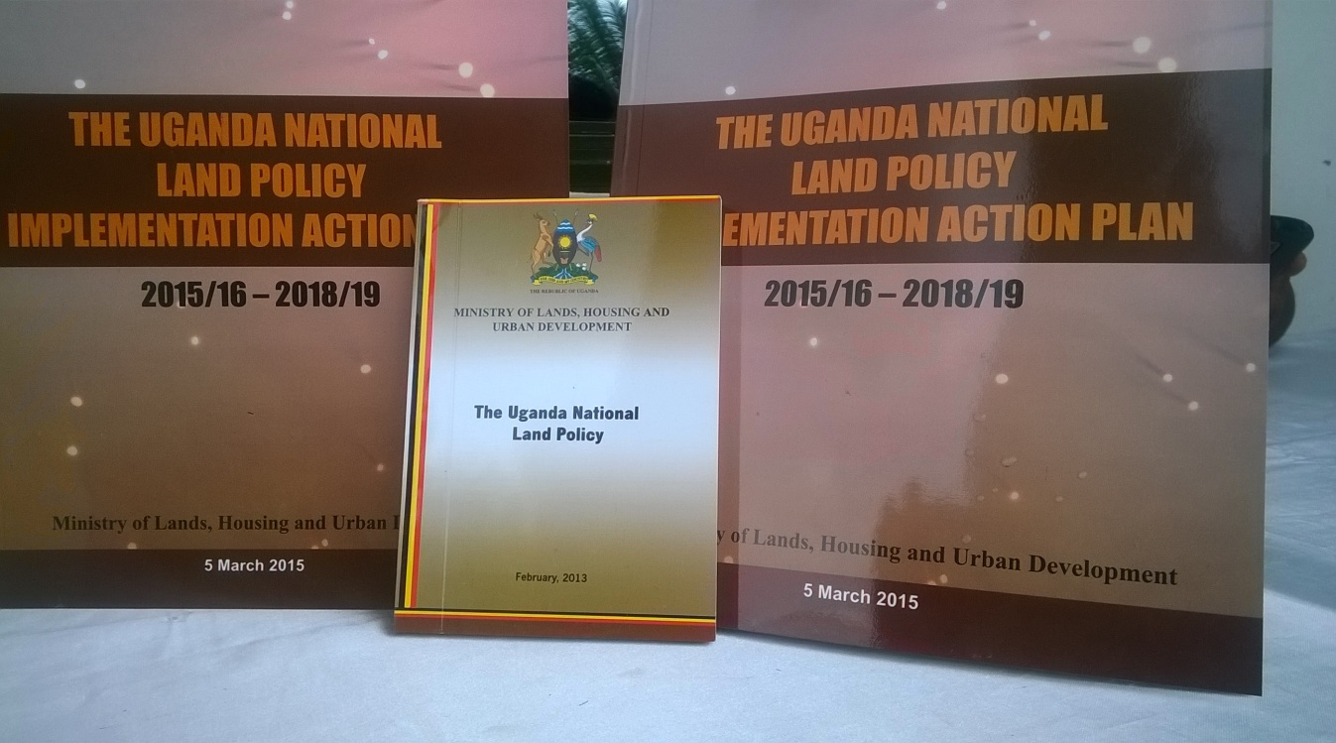
NLP IMPLEMENTATION
The National Land Policy (NLP) was approved by Cabinet in February 2013 to provide a framework for articulating the role of land in National Development , land ownership, distribution, utilization, alienability, management and control.
The Vision of the National Land Policy is “a transformed Ugandan society through optimal use and management of land resources for a prosperous and industrialized economy with a developed services sector.”
Uganda’s NLP has been implemented in a phased manner. Activities where sequenced as:
Immediate;
Short term;
Medium term as highlighted herein below.

Slide 4
NLP LINKAGES TO MACRO INSTRUMENTS & FRAMEWORKS THAT GUIDE DEVELOPMENT
Vision 2040 | objective is “A transformed Ugandan Society from a Peasant to a Modern and Prosperous Country within 30 years:” The Vision aims at making land reforms to facilitate the faster acquisition of land for planned urbanization, infrastructure development, and agricultural commercialization in order to increase household incomes, improve food security and the quality of life for all Uganda's
NRM Manifesto 2021- 2026 | To ensure that land is the biggest factor of production for most Ugandans and as such must have significant securities and guarantees for use, access and ownership.
NDP II and III | Goal “to increase household incomes and improve the quality of life of Ugandans” Plan also seeks “to increase household incomes and improve quality of life of Ugandans through strengthening Uganda’s competitiveness for sustainable wealth creation, employment, and inclusive growth of the lives of Ugandans”
SDGs & VGGTs

Slide 5
NLP IMPLEMENTATION CONT’D
(KEY PRIORITY AREAS- COMPLETED)
Immediate Actions
Establishment of an NLP Secretariat to coordinate reforms
Establishment of a Multi- Sectoral and Multi disciplinary Committee to oversee the implementation of the reforms.
Undertake Stakeholder mapping and Engagement exercise for all actors
Undertake Capacity Building, Training, and Land Rights Civic Education and Awareness Programmes for all actors
Sensitisation and awareness creation for technical staff on NLP content

Slide 6
NLP REFORMS CONT’D
Short Term Activities | Status | Remarks
M&E framework for the NLP | Developed an M&E framework to track progress implementation of the policy. | Developed through key stakeholder participation
Put in place a National Gender strategy on Land for implementing the NLP | Piloted issuance of CCOs and COOs in a number of districts in partnership with our development partners and CSOs. | Percentage of women ownership increased to 40% - 50%.
Promotion of ADR in land dispute resolution by mediation committees during mapping | Continuous training of ALCs and establishment of mediation committees to resolve land disputes during mapping. | Priority given to LC courts and Cultural institutions to handle cases of customary tenure
Undertake Institutional Reforms for efficient and effective land services Delivery. | Reengineering land administration Establishment of the MZOs Computerization of the land registry | Fully operational with all land services at 22 Ministry Zonal Offices)

Slide 7
NLP REFORMS CONT’D
Medium Term Activities | Status | Remarks
Undertake Legal and Regulatory Reform Programmes and Harmonization of Sectoral policies in conformity with the NLP, 2013. Review all land laws and Policies: RTA, Survey Act, Land Act and Land Acquisition Act Enactment of new laws and Polices | No law has been reviewed successfully and completed (Ongoing) Valuation Bill, Principles approved by Cabinet Draft LARRP Land Acquisition Bill Principles submitted to Cabinet secretariat. | No funds for consultation meeting and development of RIA (requirement) Pending development of valuation standards
Land Tenure Regularisation and Securing Land Rights. | Undertaken through GIZ program in Mailo areas of Mubende, Mityana, Kassanda and Gomba
Systematic Demarcation( SD) to secure land rights of vulnerable groups through all the tenures i.e. Mailo, Freehold &Customary | Piloted and rolled out in a number of districts. | A number of partners undertaking these programmes (UCOBAC, MUK, PELUM, IIRR among others.

Slide 8
NLP REFORMS CONT’D
Immediate Term Activities | Status | Remarks
Research and studies Capacity Assessment on the land sector. | Study undertaken by EU in 2016
Feasibility of the National Land Policy Solutions to resolve the Mailo Land Impasse | Undertaken by GIZ | Expected to feed into NLP 2.
Impact Evaluation of the performance of the NLP | Being undertaken MLHUD currently Ongoing | Expected to feed into NLP 2.
Impact Assessment of the four options on Mailo (Buyout, Leasing, Land Sharing & Coexistence between landlords and tenants through COOs) | Being undertaken in Mubende, Mityana and Kassanda | Expected to feed into NLP 2.

Slide 9
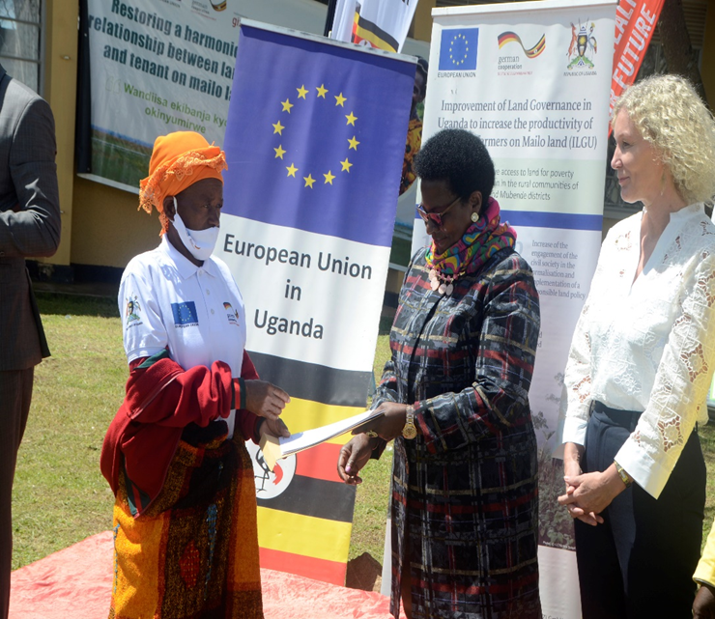
(SLAAC)
Most interventions done on Mailo Tenure
A number of districts where GIZ has carried out a number of reforms under Mailo is based on four options in the land policy (Land Sharing, Buy out, Leasing and acquiring a Certificate of Occupancy.
68 issuance Certificates of Occupancy in the districts of Mityana, Kassanda and Mubende
SLAAC for freehold in Kayunga
Team will provide more updates.
Issuance of Certificates Of Occupancy (COOS) to beneficiaries (GIZ ILGU Project) in Mubende district.

Slide 10
LEARNING LESSONS ON SLAAC
Engagement of politicians for good will.
Stakeholder Buy in.
Awareness creation to mitigate the negative perception of programmes.
Proper costing of projects.
Sustainability for continuity.

Slide 11
CHALLENGES
ON SLAAC
Lack of work flows for COOs, CLAs & CCOs on the system.
Lack of post registration guidelines.
Lack of Technical Staff in Districts where SLAAC is being implemented.
Cost of implementation is still high
Political interference/ interventions.
Lack of infrastructure in most districts.
Limited funds for most of the programmes.
Need for Capacity building for both implementers and key stakeholders.

Slide 12
WAY FORWARD
No. | ACTIVITY | TIMELINE
1. | Review Uganda’s National Land Policy (NLP)
1.1 | Assessment of progress and impact on the implementation of the National Land Policy in the last 10 years. Identify gaps, challenges and priorities to guide the future reforms. | Consultants on board
2. | Hold a 3 –day National Land Platform for all state and non state- land actors (Government, MDAs, CSOs, Academia, Private sector) to validate the findings of the Assessment Study.
2.1 | Stakeholders to show case successes, challenges and lessons learnt during implementation. | September 2023
3. | Drafting the National Land Policy for the next 10 years | December 2023 –April 2024
4. | Submission of the revised National Land Policy to Cabinet for approval | June 2024

Slide 13
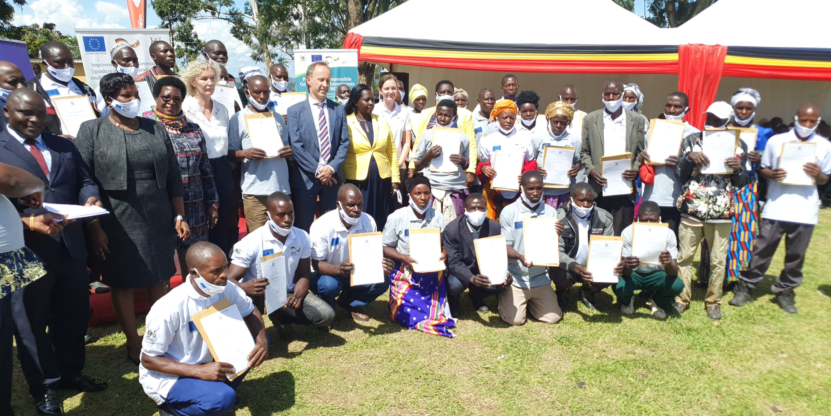
NLP IMPLEMENTATION
CONT'D (Pictorials)
Issuance of Certificates of Occupancy to beneficiaries (GIZ ILGU Project) in Mubende district.

Slide 14
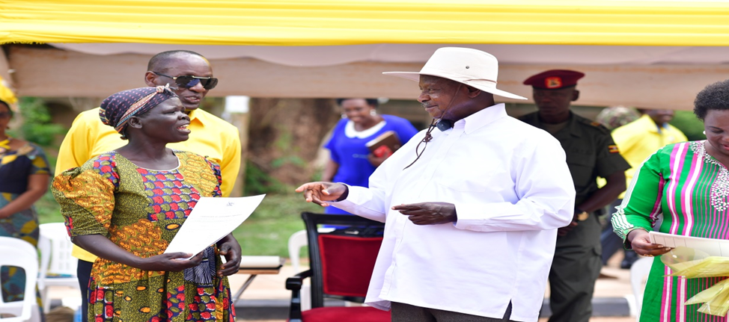
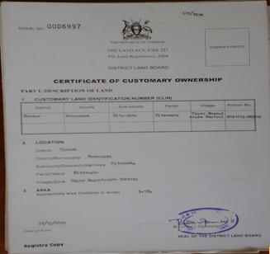
ACHIEVEMENTS CONT’D
(Pictorials)
H.E the President of Uganda issuing a Certificate of Customary Ownership to a beneficiary in Soroti District.

Slide 15
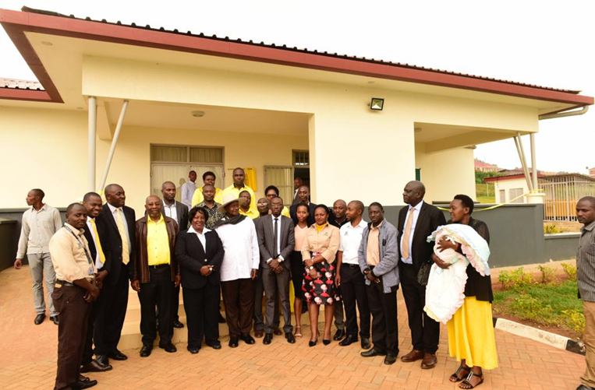
ACHIEVEMENTS CONT’D
(Pictorials)
H.E the President of Uganda at the official opening of Kabale Ministry Zonal Office with support from the World Bank to infrastructure development and computerization of the land registry.

Slide 16


