Slide 1
PROCEDURE
FOR THE DIFFERENT LAND TRANSACTIONS

Slide 2
REGISTERING A MORTGAGE

Slide 3
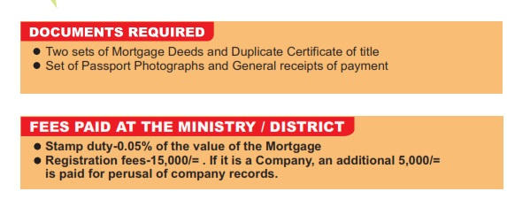
Fees and Documents required

Slide 4
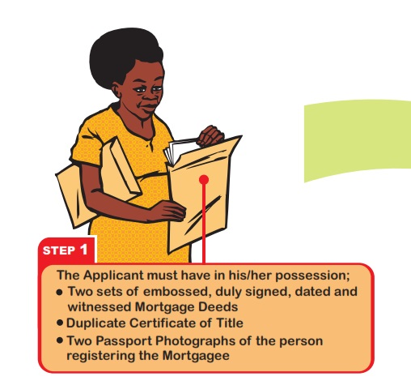
Step 1

Slide 5
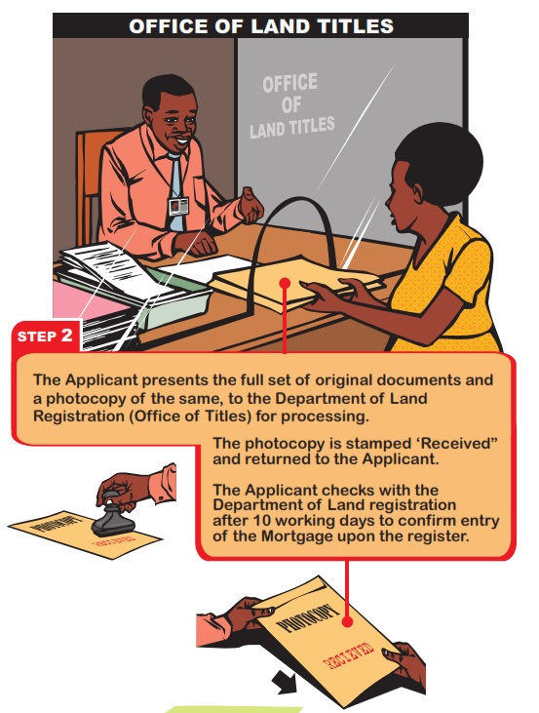
Step 2

Slide 6
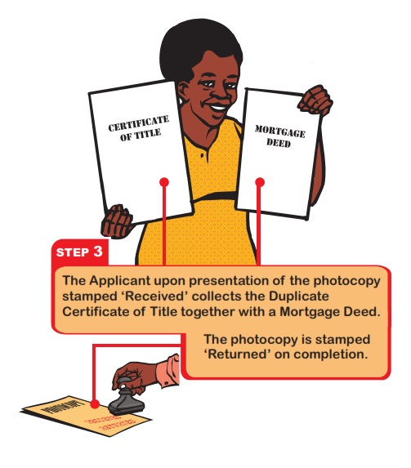
Step 3

Slide 7
ACQUIRING A FREEHOLD TITLE

Slide 8

Documents and fees required

Slide 9
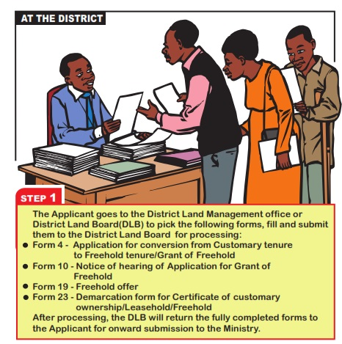
Step 1

Slide 10
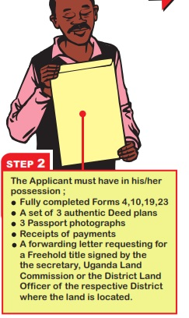
Step 2

Slide 11
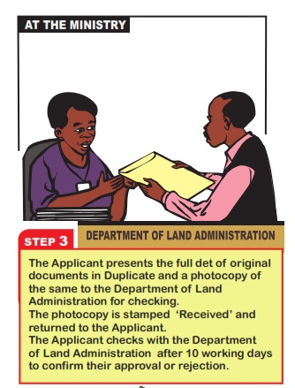
Step 3

Slide 12
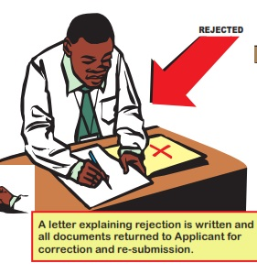
Step 4
The application can either be Rejected or Accepted
If rejected

Slide 13
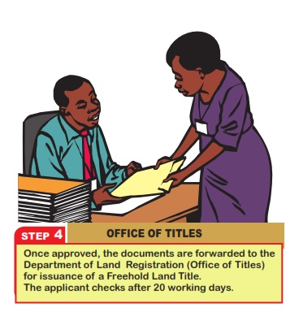
Step 4
Approved

Slide 14
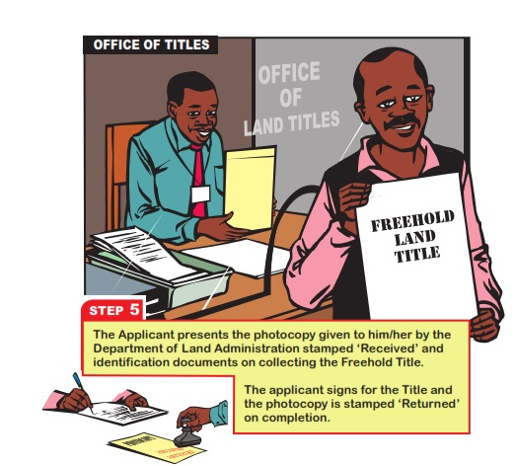
Step 5

Slide 15
ACQUIRING A LEASE HOLD TITLE

Slide 16
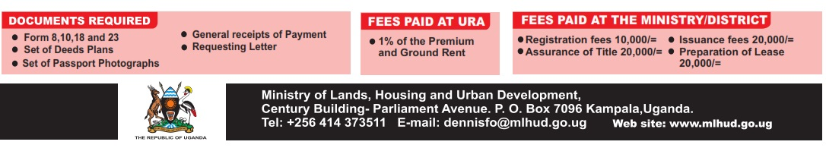
Documents and Fees required

Slide 17
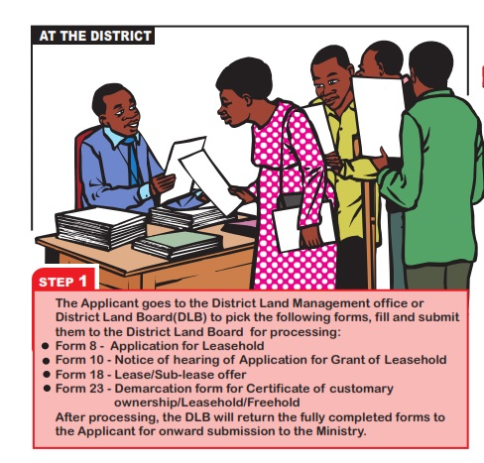
Step 1

Slide 18
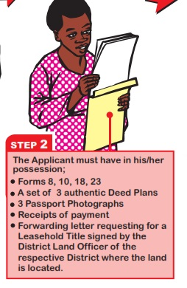
Step 2

Slide 19
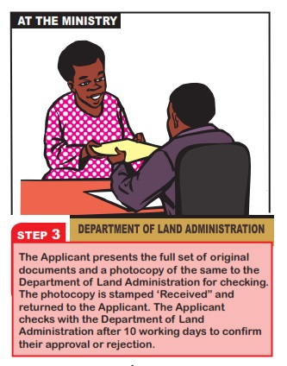
Step 3

Slide 20
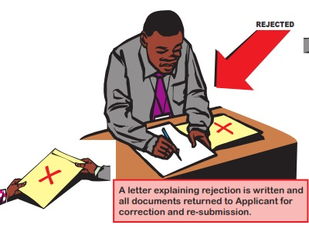
Step 4
The Application can be rejected or Approved
If approved

Slide 21
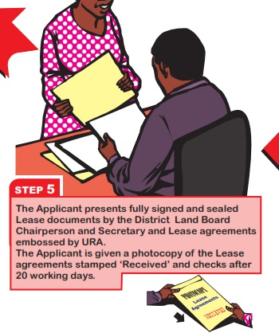
Step 4
Approved

Slide 22
Step 5

Slide 23
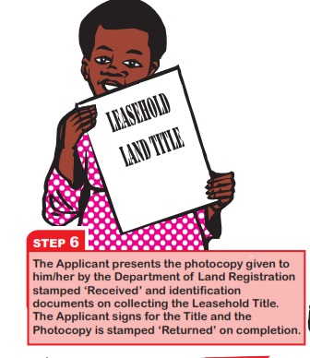
Step 6

Slide 24
TRANSFER TO A MAILO LAND

Slide 25
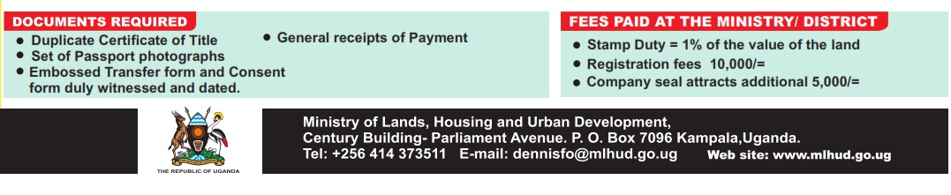
Requirements (Fees and Documents)

Slide 26
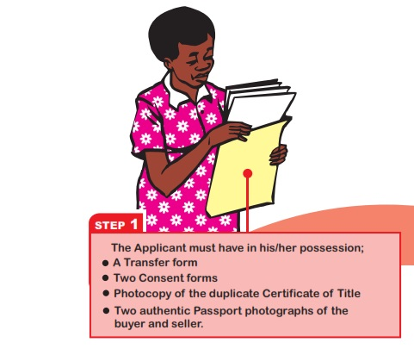
Step 1

Slide 27
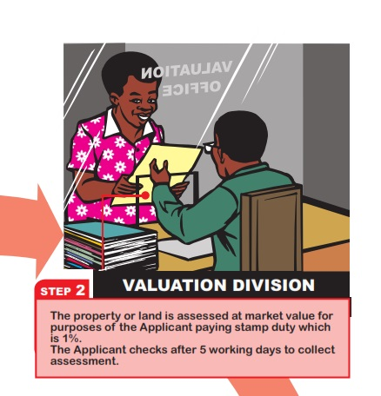
Step 2

Slide 28
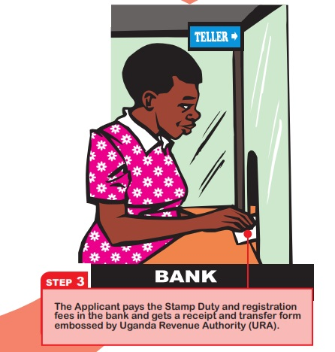
Step 3

Slide 29
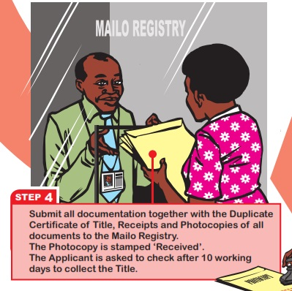
Step 4

Slide 30
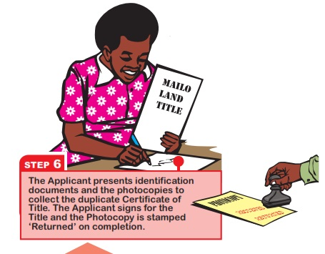
Step 5

Slide 31
REGISTERING A CAVEAT

Slide 32
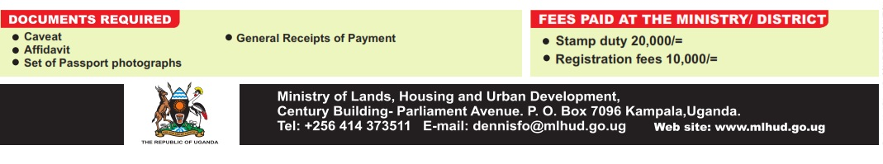
Documents and Fees Required

Slide 33
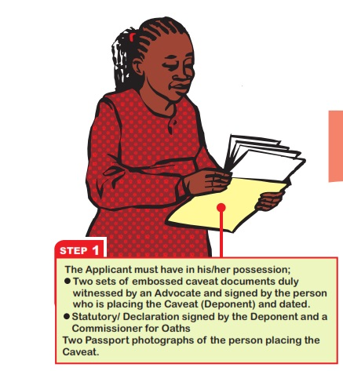
Step 1

Slide 34
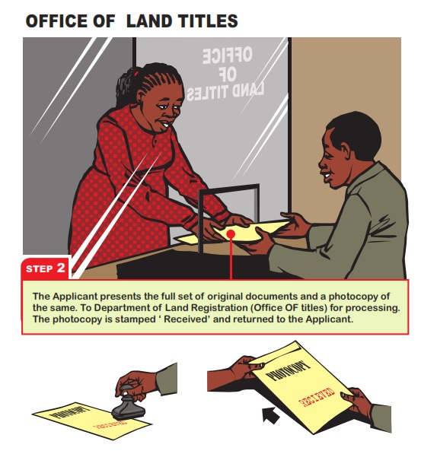
Step 2

Slide 35
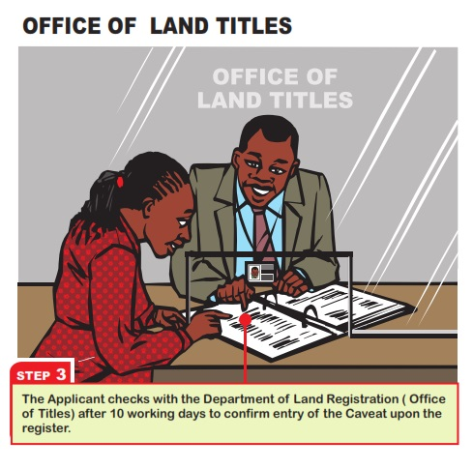
Step 3

