Slide 1
Land Governance for Social Economic Development
“The role of the MLHUD in Industrialization and Job Creation”
Mr. James Muhindo
National Coordinator – Civil Society Coalition on Oil and Gas

Slide 2
Presentation Outline
The intersection between land governance and social economic development
Prevailing challenges and bottlenecks in Land Governance that stifle Social economic Development
Recommendations to the Ministry of Lands, Housing and Urban development

Slide 3
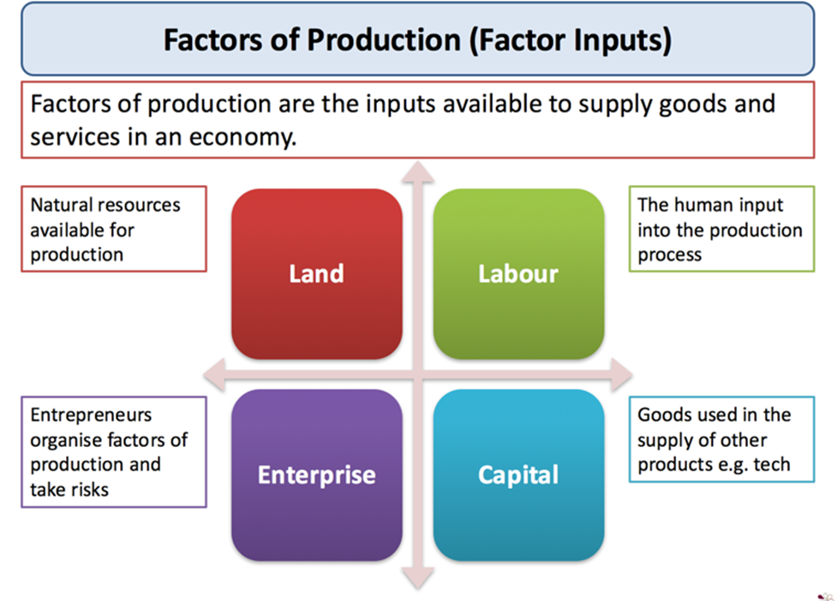
The intersection between Land Governance and Social Economic Development

Slide 4

Prevailing challenges and bottlenecks in Land Governance that stifle Social economic Development
Human attachment to the land which reduces labor mobility
Land fragmentation which limits land productivity
Procedural and bureaucratic challenges in land acquisition for industrialization
Restrictive Cultural practices that hold people to the land

Slide 5
Recommendations to the Ministry of Lands, Housing and Urban Development
Subsector | Issues | Recommendation
Land | Increased pressure on land (Climate Change, Urbanization, Population growth and food) | Strategic planning for land governance and management
Housing | Culture of attachment to the land through housing partner | Encourage millennial to be mobile through contemporary housing partners
Urban Development | Limited housing for urban population | Explore incentives for real estate developers

Slide 6


